Slide 1
ECEN 390 Electromagnetics
Introduction, Waves and Phasors

Slide 2
Sign-Up Sheets
Please volunteer throughout the semester to share a short spiritual thought at the start of each class period.
See Spiritual Thought Sign-Up Sheet in the Week 1 module or the Course Specifics Module in Canvas.
to sign up for a specific date or dates to share a thought.
Student technical presentations throughout the semester focusing on Electromagnetic Applications.
See In-Class Teaching Topics in the Week 1 module and/or the Course Specifics Module to to sign for existing topics and corresponding presentation dates available on a first-come first-serve basis. A 20 % penalty will be applied if you do not present on the designated date, unless there are extenuating circumstances as determined by the instructor.
The In-Class Teaching Topics page in the Course Specifics Module includes a grading Rubric for your Presentations.

Slide 3
Grading Overview
20% Prepare Reading and Post-Discussion Quizzes
20% Homework
20% Labs
Encouraged to collaborate, but turn in your unique work submission and not someone else's.
Labs to be done individually, although you are encouraged to help others out.
Midterm and Final exams in the Testing Center with access to an Equation Sheet, along with your personal calculator and 3 X 5 note card.
25% Exams
5% Classroom Teaching
No makeups for these quizzes. Lowest 6 quiz scores for the semester dropped.
Teach one another. 10 minute In-Class Teaching Opportunity on Electromagnetic Application.
12.5% Midterm.
10% Project
Project with formal report to be done individually.
12.5% Final.

Slide 4
ECEN 390 - ebook and Software
Textbook
Text: The text “Fundamentals of Applied Electromagnetics”, 8th edition, by Ulaby and Ravaioli. Through a company named Vitalsource, BYU-Idaho provides Automatic Access to an ebook version of this text through I-Learn for all enrolled in the class, for a 3 year time period. You will automatically be billed a cost of approximately $30 for the ebook access, with payment due after the drop deadline. A copy of this text is required for this class. You can opt out of the $30 charge if you purchase your own copy, with 6th or 7th editions fine for this class.
To access the ebook text go to the Course Materials link found on left-hand side of the Canvas course Home page.
After the initial ebook access through Canvas, you should then access the ebook through Vitalsource.
Software Tools
MATLAB - Please make sure to have MATLAB installed on your computer. MATLAB Installation Instructions.
LTspice is utilized for ECEN 390, so download and install LTspice from the Analog Devices web site using the following link: LTspice if you have not already done so. Note: the Mac version of LTspice does not provide the “Efficiency Report” needed for the Switching Regulator Project to be done near the end of the semester.
FEMM is a Finite Element Analysis (FEA) software package to be used later in the semester. Go Go to Finite Element Method Magnetics Home Page → Download → 64-bit Executable and install the software.

Slide 5
iClicker for In-Class Quizzes
We will be using the iClicker Student Mobile app for phones or laptops for in-class quizzes.
If you already have an iClicker account using your BYU-I email then you will automatically be enrolled.
If you are new to iClicker at BYU-I, then you need to create an account by visiting student.iclicker.com.
Click on Sign Up,.
Create account with Brigham Young University-Idaho as your Institution.
Use your BYU-I email, else your account won’t work for Grade Syncing at BYU-I.
If you have the wrong email on existing iClicker account, you can update your account at student.iclicker.com → Profile.
For Phones and/or Laptops
Install the iClicker Student Mobile App on your mobile Device as follows:
Download the iClicker Student Mobile app from your native app store or go to iclicker.com.

Slide 6
ECEN 390 Format and Suggestions
Prepare reading quizzes covering prepare reading material due before class with no make-ups.
Post discussion quizzes near the end of class with no make-ups. Notes taken during class can be used on these quizzes. (6 lowest quiz scores for the semester automatically dropped by Canvas.)
Download and use the class slides presented in class, all of which are available on Canvas. These slides include worked examples similar to many homework problems.
5% per day with a maximum of 50% late penalty for homework and lab assignments, unless extenuating circumstances as determined by the instructor.
Midterm and Final Exams similar to homework problems in the Testing Center with access to an Equation Sheet, along with your personal calculator and 3 X 5 note card.
Work in groups on homework to teach one another, although turn in your own work. Identical homework submissions are considered plagiarism and assigned a grade of 0.
AI Policy: Use of AI is encouraged, although be wise, realizing that submitting AI authored text is plagiarism and at times AI confidently provides incorrect responses. Also, keep in mind that AI is not available for the midterm and final examinations.
Do follow the Honor Code: “As you live with integrity you will have personal peace and self respect”. President Meredith, BYUI-I Devotional on 9/12/2023.

Slide 7
ECEN 390 Language Challenge
The Book of Mormon utilized a concise language referred to as “Reformed Egyptian”.
Electromagnetics utilizes a concise language referred to as mathematics, much in the form of vector algebra and vector calculus.
Becoming fluent in mathematics will aid your entire engineering career. Strive to become an engineer that embraces, rather than runs from, technical opportunities that utilize the language of mathematics.
Let’s strive for mathematical language proficiency along with overall understanding of the challenging topic of electromagnetics.

Slide 8
ECEN 390 – Electromagnetics Relevance
If you do not know the answers to the following questions, hopefully you will at the completing this course.
What is a 50 Ω coaxial cable?
Do I need to understand transmission lines and impedance matching if I am a digital designer?
Do electrons travel near the speed of light in high-speed cables?
How does a microwave oven heat food?
How does placing a solid insulator between capacitor plates increase the capacitance?
Why do some capacitors have a specific positive an negative terminal, such as aluminum electrolytic capacitors?
How does a DC/DC Converter (Switching Voltage Regulator) work?
What is antenna gain?
A working knowledge of “Electromagnetics (EM)” is a highly sought after skill today, and in the foreseeable future.
Maxwell's equations are a set of equations that, together with the Lorentz force law, form the foundation of classical electromagnetism, classical optics, and electric circuits. (Wikipedia.)

Slide 9
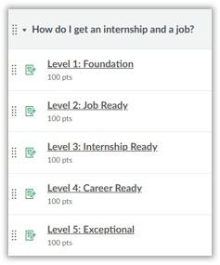
Internship and Job Preparation
To aid in your landing an internship and a job, the following Canvas course titled 'CSE Majors’ has been developed to help your progress through various levels of rediness:
at: https://byui.instructure.com/courses/48558/modules.
The levels correspond to where you should be based on your year in school
(i.e., you should be at Level 1 your freshman year, Level 2 your sophomore year,
and so forth). You will not be graded on the completion of levels and tasks in
this course, but it is in your best interest to make steady progress.
This course encourages the development of a Portfolio, in addition to a Resume.
Portfolios include Presentations and Projects that you have completed that distinguishes you from other applicants.
The slides for your In-Class Teaching Topic for this course would be a good item to add to your Portfolio, assuming you put together a good quality presentation.
Also, your Power Supply Project Report to be submitted at the end of this semester for this course would be a good item to add to your Portfolio, assuming you do good quality work on that project and the accompanying report.

Slide 10
ECEN 390 – Electromagnetics Topics
Waves and Phasors
Transmission Lines
Vector Calculus
Electrostatics
Magnetostatics
Time Varying Fields
Plane Wave Propagation
Radiation and Antennas
Satellites and Radar

Slide 11
Electromagnetics Development Time Line
900 BC – Shephard named Magnus felt magnetic attraction due to magnetite attracting iron nails in his shoes (Legend).
1000 – Magnetic Compass used for navigation.
1600 – William Gilbert realized compass needle points north-south because of earth being a large bar magnet.
1671 – Isaac Newton demonstrated white light was a mixture of colors.
1733 – Charles-Francois du Fay discovers two types of electrical charges, later referred to a positive and negative.
1745 – Pieter van Musschenbroek invents capacitor (Leyden Jar).
1752 – Benjamin Franklin invents the lightning rod and demonstrates that lightning is electricity.
1785 – Charles-Augustin de Coulomb formulates Coulombs law describing the forces between electrical charges.
1800 – Alessandro Volta develops first electric battery.
1820 – Andre-Marie Ampere observes that parallel current carrying wires induce forces on each other.
1820 – Georg Ohm formulates Ohm’s law.
1827 – Joseph Henry introduces the concept of inductance.
1831 – Michael Faraday discovers that changing magnetic flux can induce an electromotive force (emf).
1835 – Carl Friedrich Gauss formulates Gauss’s law relating electric flux to enclosed charge.
1873 – James Clerk Maxwell combines the discoveries of Coulomb, Oersted, Ampere, and Faraday into the now famous Maxwell’s Equations.
1887 – Heinrich Hertz Generates Radio Waves.
1888 – Nikola Tesla invents the alternating current (ac) motor.
1897 – Joseph Thomson discovers the electron and measures its charge-to-mass ratio.
1905 – Albert Einstein explains the photoelectric effect. (emission or ejection of electrons from metals by means of incident light).

Slide 12
Telecommunications Development Time Line
1825 – Electromagnet.
1837 – Telegraph.
1876 – Telephone.
1887 – Heinrich Hertz Generates Radio Waves.
1893 – Valdemar Poulsen invents Magnetic Sound Recording.
1897 – Karl Braun invents Cathode Ray Tube.
1902. – Reginald Fessenden invents Amplitude Modulation.
1912 – Lee de Forest invents the triode vacuum tube.
1919 – Edwin Armstrong invents the Superheterodyne Radio Receiver.
1920 – Birth of Commercial Radio Broadcasting.
1923 – Vladimir Zworkykin invents Television Camera (iconoscope). Some credit this as invention of TV, but is controversial.
1927 – Philo Farnsworth achieves successful transmission of Television signals.
1933 – Edwin Armstrong invents Frequency Modulation.
1935 – Robert Watson-Watt invents radar (radio detection and ranging).
1947 – Shockley, Brattain and Bardeen invent the bipolar junction transistor.
1958 – Jack Kilby credited for building the first Integrated Circuit.
1983 – Cellular phone networks start in the US.
1984 – Worldwide Internet become operational.

Slide 13
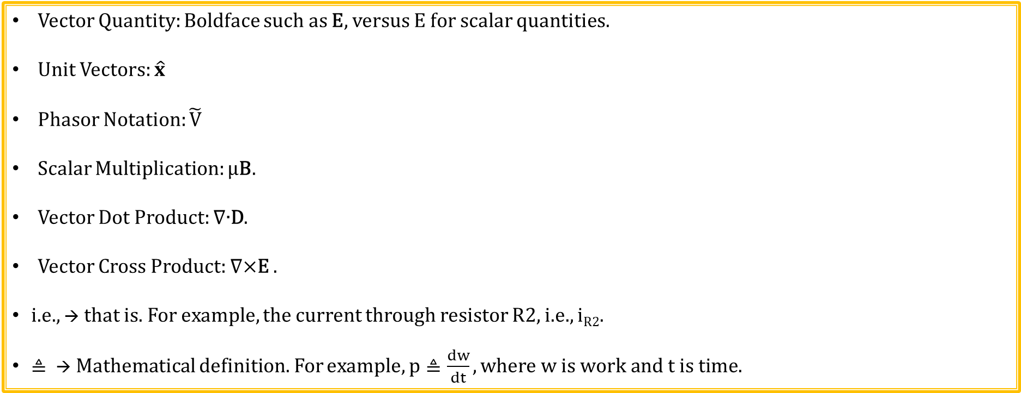
Notational Summary
Vector Quantity: Boldface such as E, versus E for scalar quantities.
Unit Vectors: $\hat{x}$
Phasor Notation: $\tilde{V}$
Scalar Multiplication: µB.
Vector Dot Product: $\text{∇}\text{∙}\text{D}$.
Vector Cross Product: $\text{∇}\text{×}\text{E} \text{.}$
i.e., → that is. For example, the current through resistor R2, i.e., i_{R2}.
$≜$ → Mathematical definition. For example, $p≜\frac{dw}{dt}, where w is work and t is time.$

Slide 14
Dimensions and Units
Primary (Basic) Dimensions are mass, length, time, temperature, electric current , luminous intensity, and amount of substance.
A unit is a way to assign a numerical value to a dimension, such as feet or meters for length.
SI (International System) Units, i.e., metric units, are commonly used in science and engineering, although English units such as feet and miles also use.
For example, the Coulomb is a unit of charge having dimensions of (Current)(Time).
Dimensionless Quantity – No physical dimensions such as the ratio of two lengths in which the dimension length cancels out in the ratio.
Unit-less Quantity – No associated units, such as the ratio of two resistors.
Sometimes units are assigned to dimensionless quantities such as radians for angles. The unit radian is defined as the angle formed by an arc length equal to the radius of a circle, i.e., a dimensionless quantity, yet having specific defined units.
So all unit-less quantities are also dimensionless, but not all dimensionless quantities are unit-less.

Slide 15
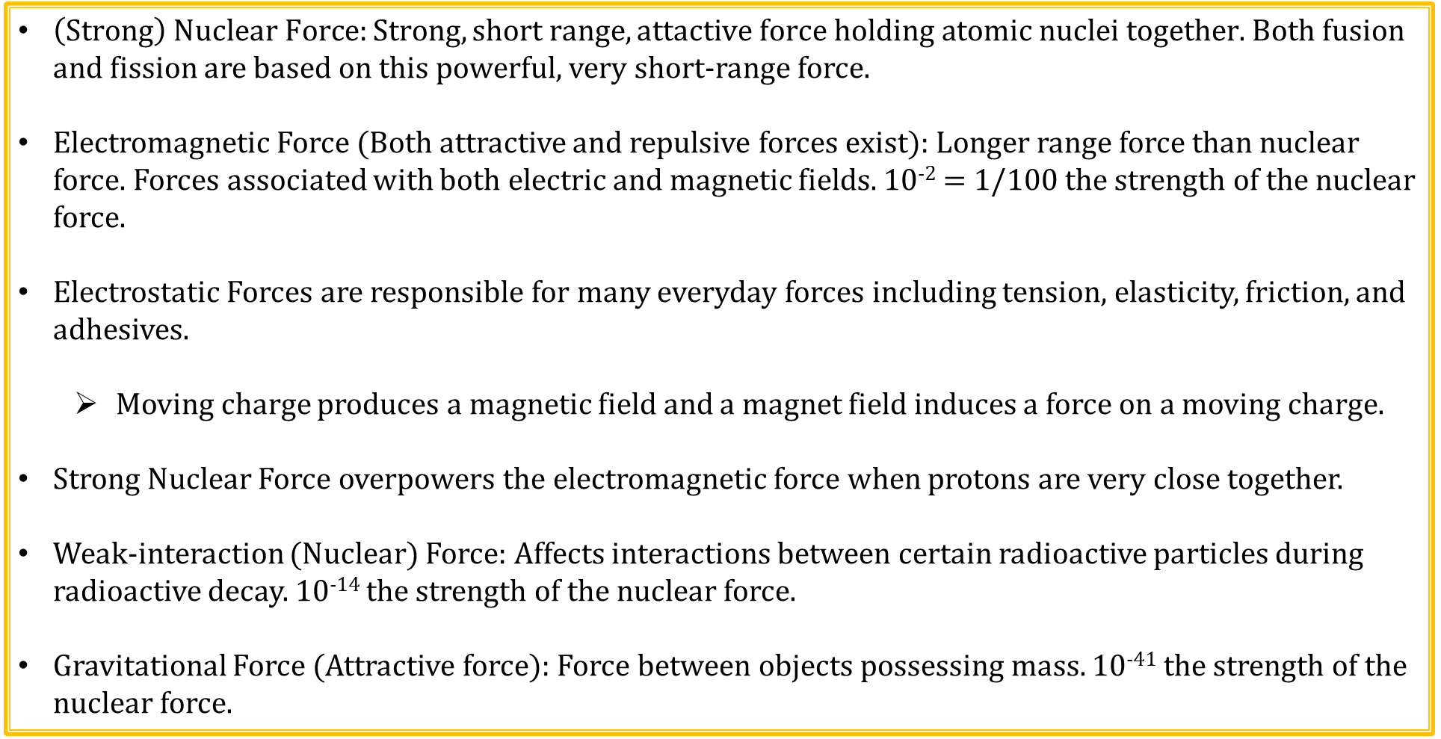
Fundamental Forces of Nature
$\left(Strong\right) Nuclear Force:Strong, short range, attactive force holding atomic nuclei together.$ Both fusion and fission are based on this powerful, very short-range force.
Electromagnetic Force (Both attractive and repulsive forces exist): Longer range force than nuclear force. Forces associated with both electric and magnetic fields. 10⁻² = 1/100 the strength of the nuclear force.
Electrostatic Forces are responsible for many everyday forces including tension, elasticity, friction, and adhesives.
Moving charge produces a magnetic field and a magnet field induces a force on a moving charge.
Strong Nuclear Force overpowers the electromagnetic force when protons are very close together.
Weak-interaction (Nuclear) Force: Affects interactions between certain radioactive particles during radioactive decay. 10⁻¹⁴ the strength of the nuclear force.
Gravitational Force (Attractive force): Force between objects possessing mass. 10⁻⁴¹ the strength of the nuclear force.

Slide 16
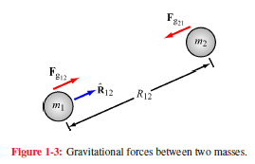
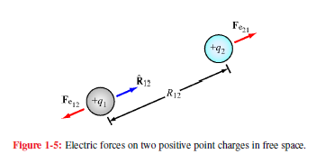
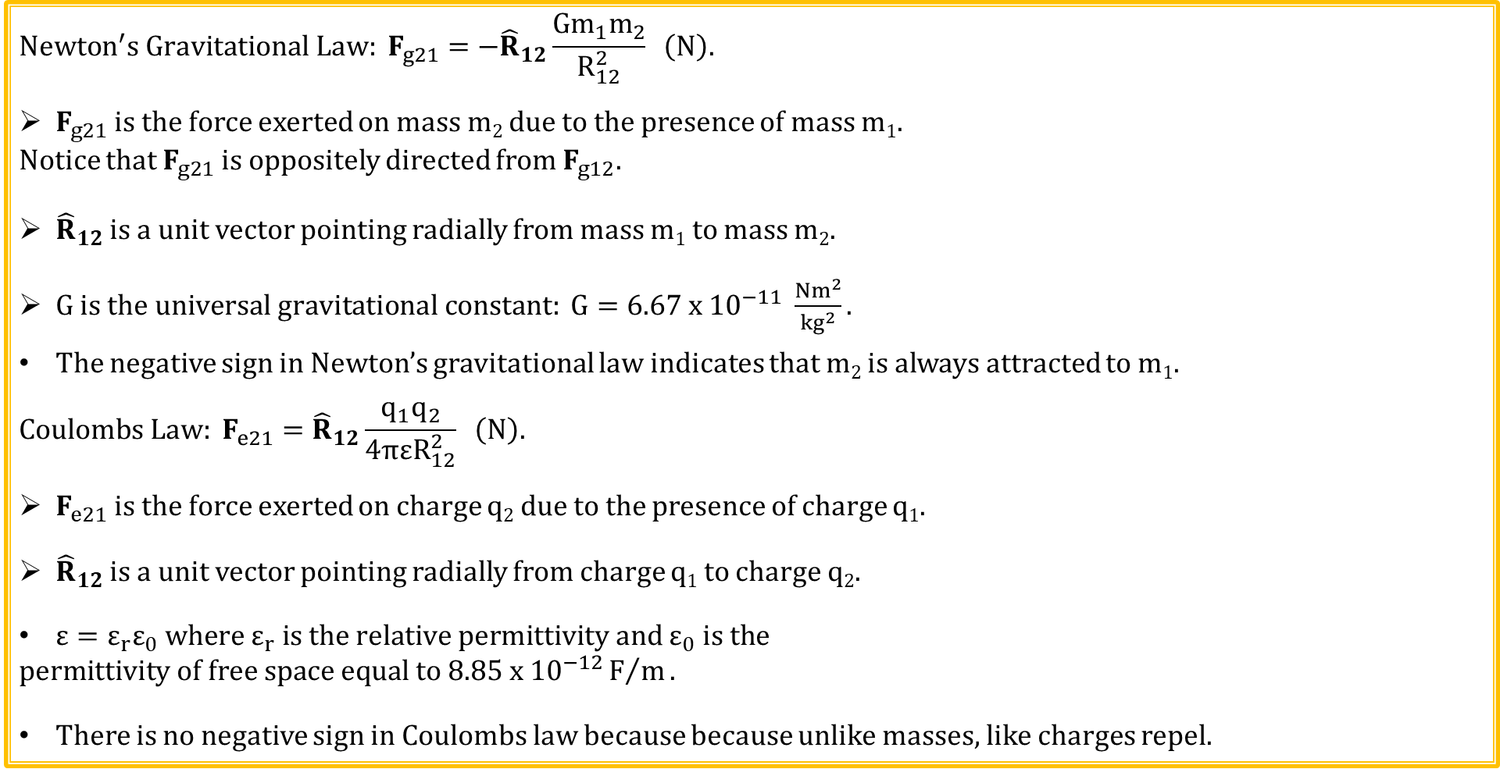
Newton’s and Coulomb’s Law
$$Newton^{′}s Gravitational Law: F_{g21}={−\hat{R}}_{12}\frac{Gm_{1}m_{2}}{R_{12}^{2}} \left(N\right).$$
$F_{g21}$is the force exerted on mass m₂ due to the presence of mass m₁.
Notice that $F_{g21}$is oppositely directed from $F_{g12}.$
${\hat{R}}_{12}$ is a unit vector pointing radially from mass m₁ to mass m₂.
$G is the universal gravitational constant: G=6.67 x {10}^{−11} \frac{Nm^{2}}{{kg}^{2}}.$
The negative sign in Newton’s gravitational law indicates that m₂ is always attracted to m₁.
$$Coulombs Law: F_{e21}={\hat{R}}_{12}\frac{q_{1}q_{2}}{4πεR_{12}^{2}} \left(N\right).$$
$F_{e21}$is the force exerted on charge q₂ due to the presence of charge q₁.
${\hat{R}}_{12}$ is a unit vector pointing radially from charge q₁ to charge q₂.
$ε=ε_{r}ε_{0} where ε_{r} is the relative permittivity and ε_{0} is the$
$$permittivity of free space equal to 8.85 x {10}^{−12}F/m.$$
There is no negative sign in Coulombs law because because unlike masses, like charges repel.

Slide 17
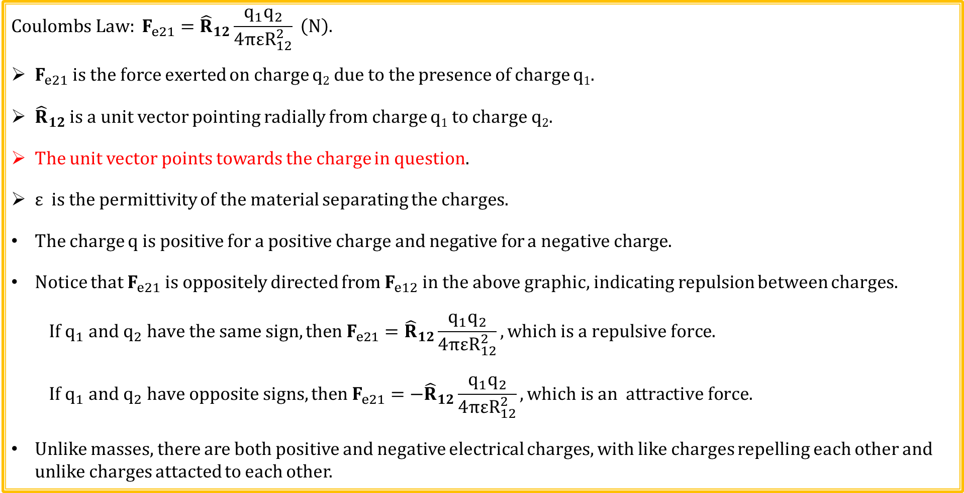
Coulomb’s Law (Continued)
$$Coulombs Law: F_{e21}={\hat{R}}_{12}\frac{q_{1}q_{2}}{4πεR_{12}^{2}} \left(N\right).$$
$F_{e21}$is the force exerted on charge q₂ due to the presence of charge q₁.
${\hat{R}}_{12}$ is a unit vector pointing radially from charge q₁ to charge q₂.
The unit vector points towards the charge in question.
ε is the permittivity of the material separating the charges.
The charge q is positive for a positive charge and negative for a negative charge.
Notice that $F_{e21}$is oppositely directed from $F_{e12}$ in the above graphic, indicating repulsion between charges.
$$If q_{1} and q_{2} have the same sign, then F_{e21}={\hat{R}}_{12}\frac{q_{1}q_{2}}{4πεR_{12}^{2}}, which is a repulsive force.$$
$$If q_{1} and q_{2} have opposite signs, then F_{e21}={−\hat{R}}_{12}\frac{q_{1}q_{2}}{4πεR_{12}^{2}}, which is an attractive force.$$
Unlike masses, there are both positive and negative electrical charges, with like charges repelling each other and unlike charges attacted to each other.

Slide 18
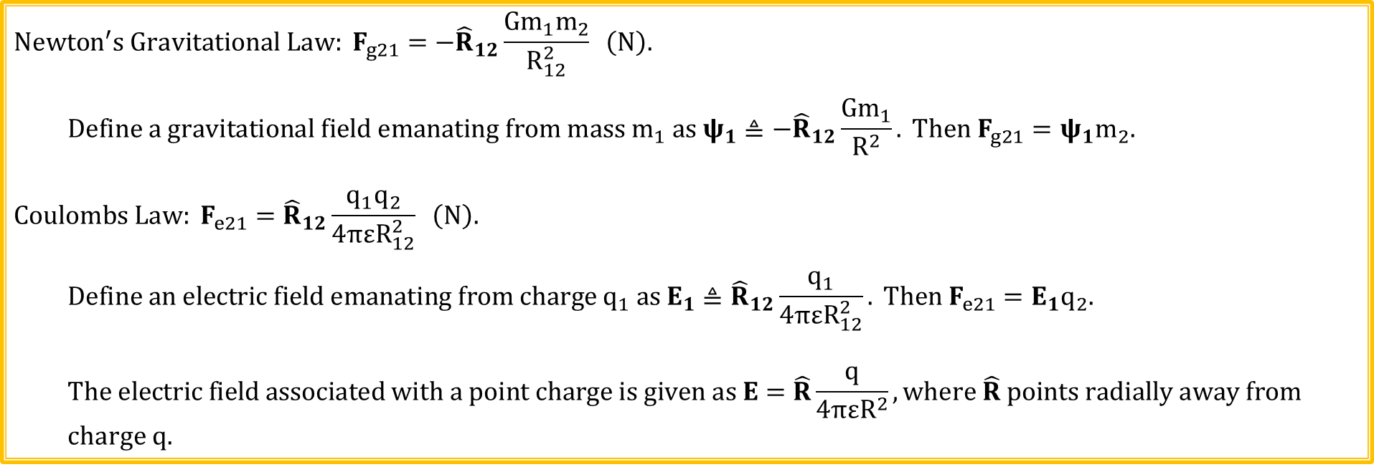
Newton’s and Coulomb’s Law (Continued)
$$Newton^{′}s Gravitational Law: F_{g21}={−\hat{R}}_{12}\frac{Gm_{1}m_{2}}{R_{12}^{2}} \left(N\right).$$
$$Define a gravitational field emanating from mass m_{1} as ψ_{1}≜{−\hat{R}}_{12}\frac{Gm_{1}}{R^{2}}. Then{ F}_{g21}=ψ_{1}m_{2}.$$
$$Coulombs Law: F_{e21}={\hat{R}}_{12}\frac{q_{1}q_{2}}{4πεR_{12}^{2}} \left(N\right).$$
$$Define an electric field emanating from charge q_{1} as E_{1}≜{\hat{R}}_{12}\frac{q_{1}}{4πεR_{12}^{2}}. Then{ F}_{e21}=E_{1}q_{2}.$$
$$The electric field associated with a point charge is given as E=\hat{R}\frac{q}{{4πεR}^{2}},\text{where} \hat{R} \text{points} \text{radially} \text{away} \text{from}$$
charge q.

Slide 19
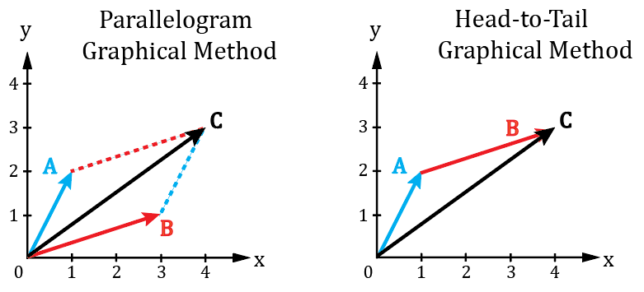

Vector Addition
$$A=\hat{x}1+\hat{y}2. B=\hat{x}3+\hat{y}1.$$
$$C=A+B=\hat{x}\left(1+3\right)+\hat{y}\left(2+1\right)=\hat{x}4+\hat{y}3.$$

Slide 20
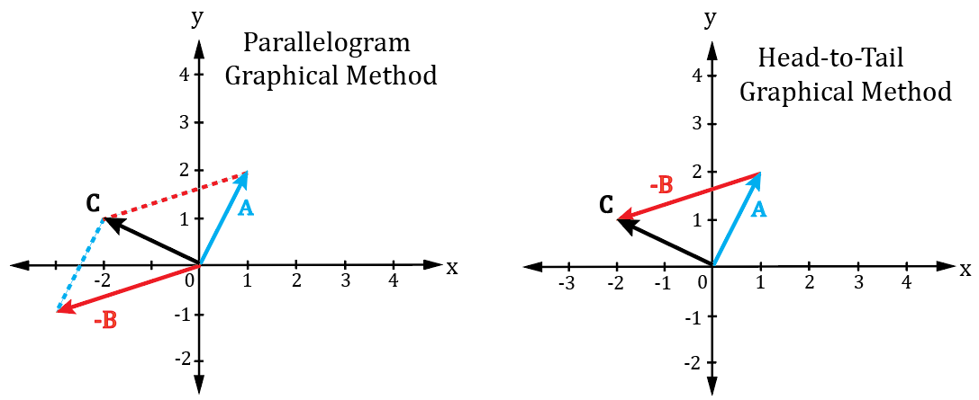

Vector Subtraction
$$A=\hat{x}1+\hat{y}2. B=\hat{x}3+\hat{y}1.$$
$$C=A−B=\hat{x}\left(1−3\right)+\hat{y}\left(2−1\right)=−\hat{x}2+\hat{y}1.$$

Slide 21
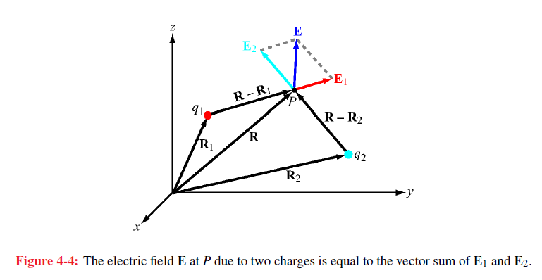
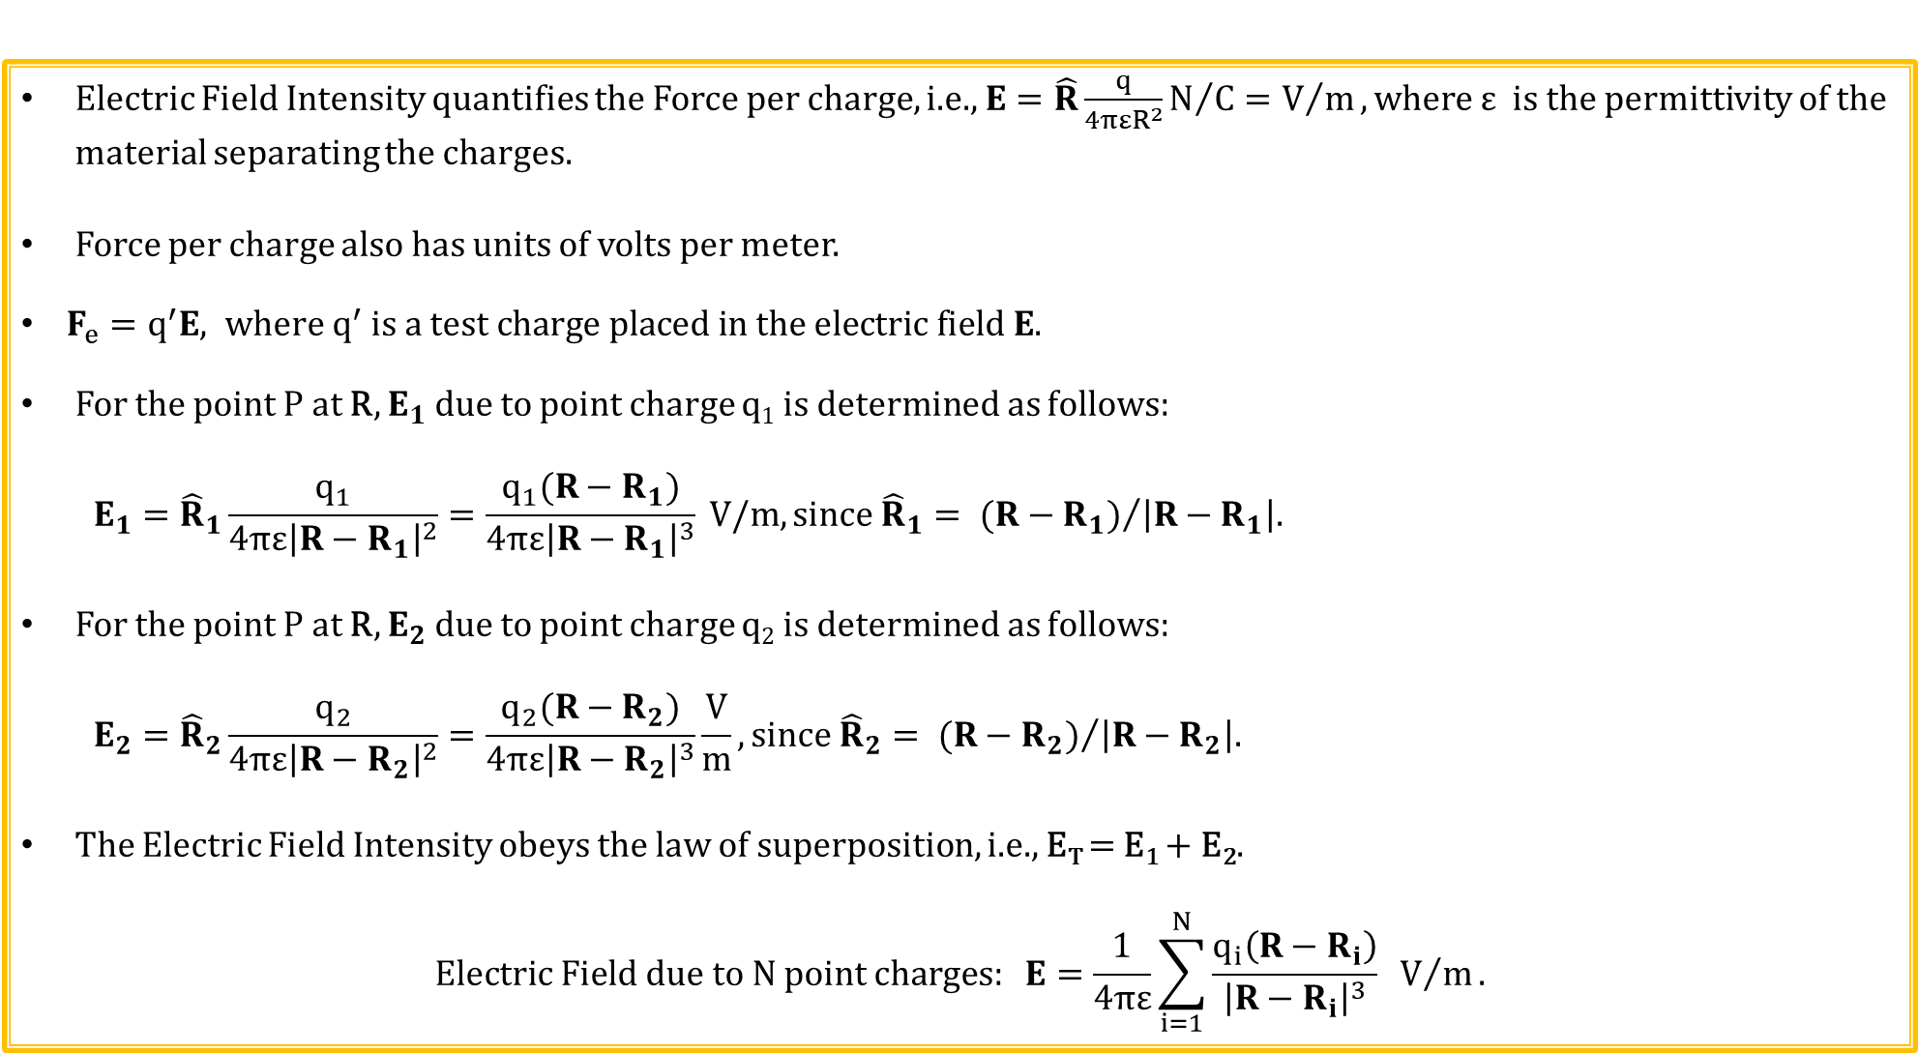
Electric Fields
Electric Field Intensity quantifies the Force per charge, i.e., $E=\hat{R}\frac{q}{4πεR^{2}}N/{C=V/m}, where$ε is the permittivity of the material separating the charges.
Force per charge also has units of volts per meter.
$F_{e}=q^{′}E, where q^{′} is a test charge placed in the electric field E.$
For the point P at R, $E_{1}$ due to point charge q₁ is determined as follows:
$$E_{1}={\hat{R}}_{1}\frac{q_{1}}{4πε{\left|R−R_{1}\right|}^{2}}=\frac{q_{1}(R−R_{1})}{4πε{\left|R−R_{1}\right|}^{3}} V/m, since {\hat{R}}_{1}= {(R−R_{1})}/{\left|R−R_{1}\right|.}$$
For the point P at R, $E_{2}$ due to point charge q₂ is determined as follows:
$$E_{2}={\hat{R}}_{2}\frac{q_{2}}{4πε{\left|R−R_{2}\right|}^{2}}=\frac{q_{2}(R−R_{2})}{4πε{\left|R−R_{2}\right|}^{3}}\frac{V}{m}, since {\hat{R}}_{2}= {(R−R_{2})}/{\left|R−R_{2}\right|.}$$
The Electric Field Intensity obeys the law of superposition, i.e., E_{T} = E₁ + E₂.
$$Electric Field due to N point charges: E=\frac{1}{4πε}\sum_{i=1}^{N}{\frac{q_{i}\left(R−R_{i}\right)}{{\left|R−R_{i}\right|}^{3}} V/m}.$$

Slide 22
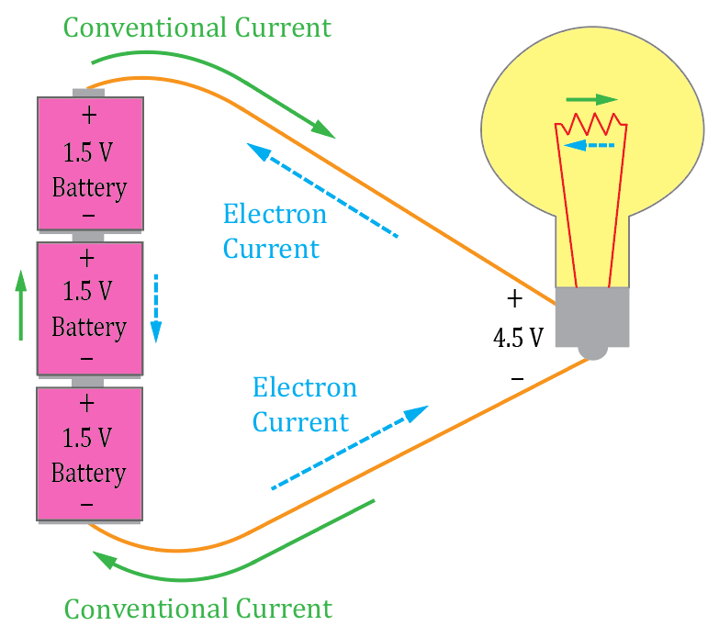
Conventional versus Electron Current
Since there are both positive and negative charges, the flow of electrical charge can consist of positive charge flowing from a positive to negative voltage, or negative charge flowing from a negative to positive voltage.
Examples of positive charge flow are positively charged lithium ions
in a Lithium-ion battery, and hydrogen ions, i.e., protons, in a fuel cell.
Examples of negative charge flow are electrons moving in a metallic
conductor like copper, and electrons moving through a transistor.
So, should current be designated as positive charge flowing from positive to
negative voltage, or as negative charge flowing from negative to positive voltage?
In 1750 Benjamin Franklin theorized electrical current was a flow of positive
charge carriers, which became known as Conventional Current. Whereas charge
transfer involving negative charge, such as electrons in a metallic conductor, is more common in electronics, and is referred to as Electron Current.
For circuit analysis, the results are the same whether Conventional or Electron Current flow is assumed.
So, today, Conventional Current (positive charge transfer from + to – voltage) is traditionally used to illustrate and calculate currents in circuits, even though Electron Current is often the actual current flow mechanism.

Slide 23
Conventional versus Electron Current Flow
Electric Field
+
+
+
+
+
+
+
Electric Field
+
+
+
+
+
+
+
Electric Field
+
+
+
+
+
+
+
In a copper wire, only electrons contribute to current flow, not fixed metal atoms held together by covalent bonds. Free outer electrons hop from atom to atom, resulting in location of ionized atoms appearing to move in the opposite direction. Yet only electrons move in the wire.
So electrons moving to the left has the same affect as if positive charge moved to the right, which somewhat justifies the continuing usage of conventional current flow.

Slide 24
Waves
Amplitude
Distance
A wave is a function of both with time (t) and distance (x).
Sound waves → Pressure disturbances traveling through the air.
Transmission Line Waves → Finite propagation velocity of voltage and current changes results in wave propagation.
Electromagnetic Waves → Oscillating electric and magnetic fields that travel through space, including a vacuum.
Moving waves carry energy.
Moving waves have velocity.

Slide 25
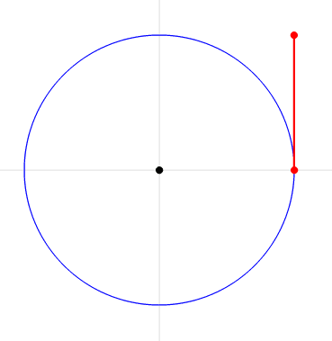
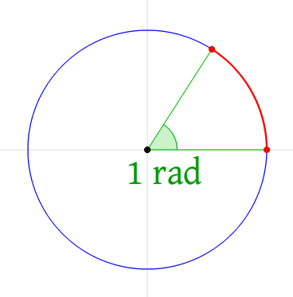
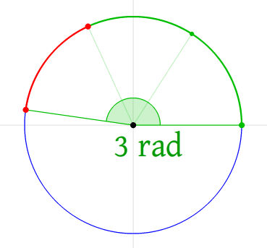
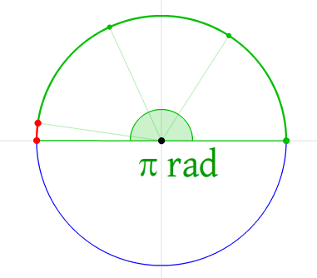
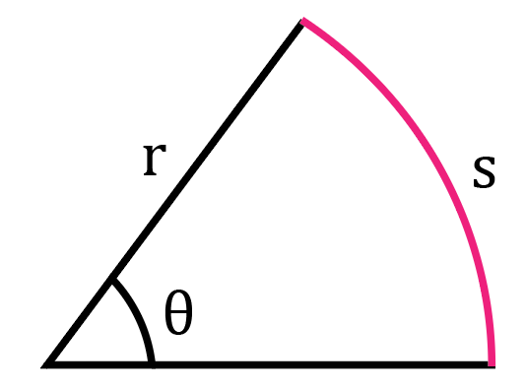
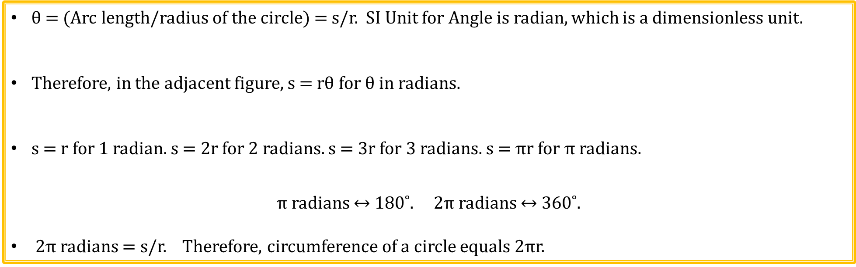
Radian Angles
r
r
r
θ = (Arc length/radius of the circle) = s/r. SI Unit for Angle is radian, which is a dimensionless unit.
Therefore, in the adjacent figure, s = rθ for θ in radians.
s = r for 1 radian. s = 2r for 2 radians. s = 3r for 3 radians. s = $π$r for $π$ radians.
$π$ radians ↔ 180˚. 2$π$ radians ↔ 360˚.
2$π$ radians = s/r. Therefore, circumference of a circle equals 2$π$r.

Slide 26
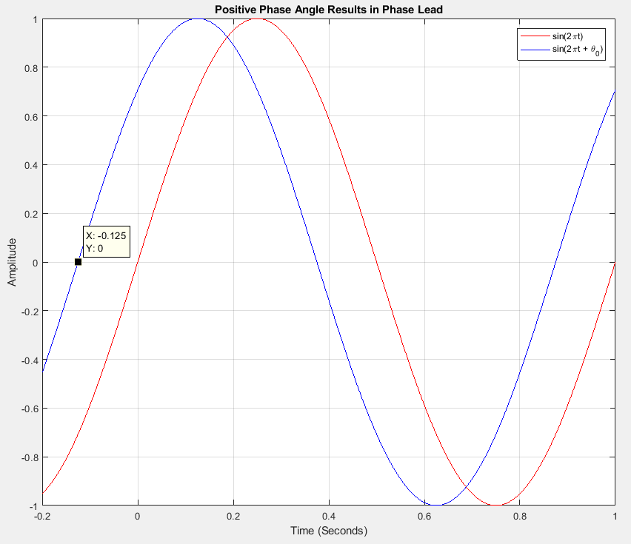
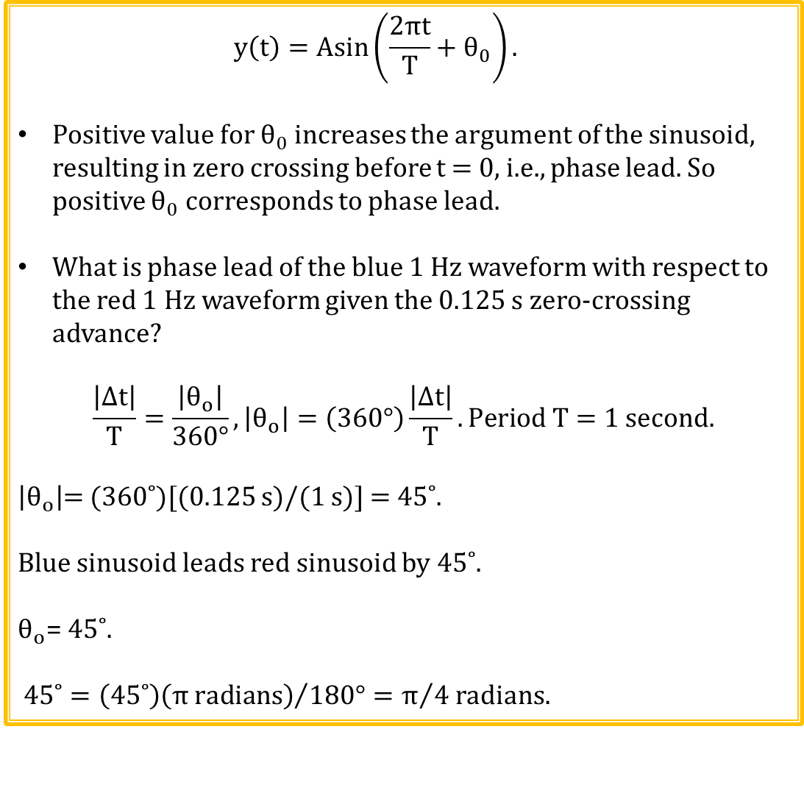
Sinusoidal Waveforms and Phase Lead
$$y\left(t\right)=Asin\left(\frac{2πt}{T}+θ_{0}\right).$$
Positive value for $θ_{0}$ increases the argument of the sinusoid, resulting in zero crossing before t = 0, i.e., phase lead. So positive $θ_{0}$ corresponds to phase lead.
What is phase lead of the blue 1 Hz waveform with respect to the red 1 Hz waveform given the 0.125 s zero-crossing advance?
$$\frac{\left|∆t\right|}{T}=\frac{\left|θ_{o}\right|}{360°}, \left|θ_{o}\right|=\left(360°\right)\frac{\left|∆t\right|}{T}. Period T=1 second.$$
$\left|θ_{o}\right|$= (360˚)[(0.125 s)/(1 s)] = 45˚.
Blue sinusoid leads red sinusoid by 45˚.
$θ_{o}$= 45˚.
${\text{45}\text{˚}=\left(\text{45}\text{˚}\right)\left(π radians\right)}/{180°}=π/4$ radians.
Red Trace is the Reference Wave

Slide 27
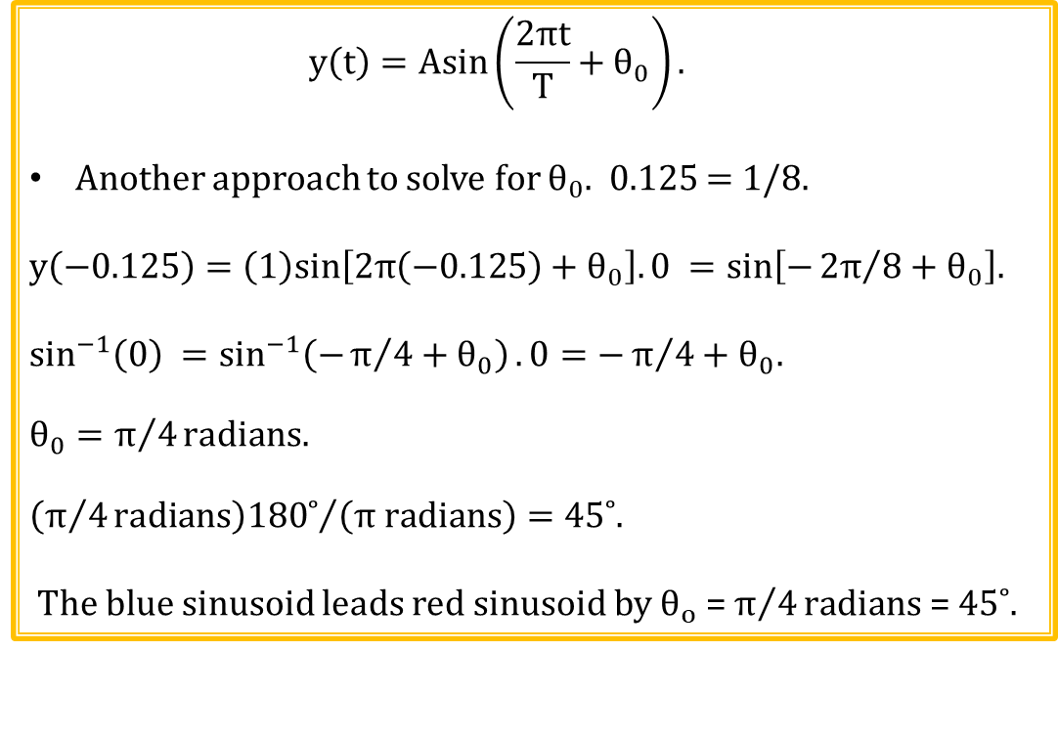
Sinusoidal Waveforms and Phase Lead (Continued)
$$y\left(t\right)=Asin\left(\frac{2πt}{T}+θ_{0}\right).$$
Another approach to solve for $θ_{0}$. 0.125 = 1/8.
$$y\left(−0.125\right)=\left(1\right)sin\left[2π\left(−0.125\right)+θ_{0}\right].0 =sin\left[−{2π}/8+θ_{0}\right].$$
$$\sin^{−1}\left(0\right) =\sin^{−1}\left(−π/4+θ_{0}\right). 0=−π/4+θ_{0}.$$
$$θ_{0}=π/4radians.$$
${\left(π/4radians\right)180˚}/{\left(π radians\right)}=\text{45˚}$.
The blue sinusoid leads red sinusoid by $θ_{o}$ = $π/4radians$ = 45˚.

Slide 28
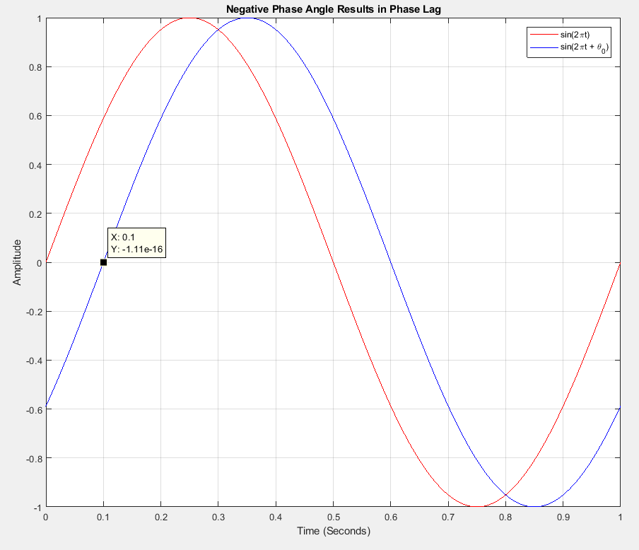
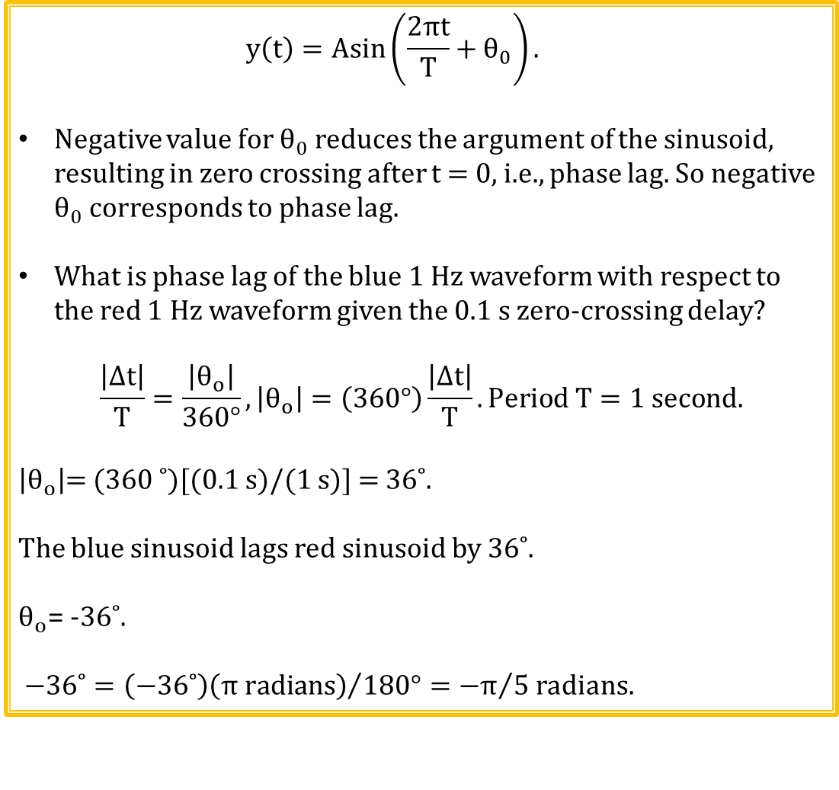
Sinusoidal Waveforms and Phase Lag
$$y\left(t\right)=Asin\left(\frac{2πt}{T}+θ_{0}\right).$$
Negative value for $θ_{0}$ reduces the argument of the sinusoid, resulting in zero crossing after t = 0, i.e., phase lag. So negative $θ_{0}$ corresponds to phase lag.
What is phase lag of the blue 1 Hz waveform with respect to the red 1 Hz waveform given the 0.1 s zero-crossing delay?
$$\frac{\left|∆t\right|}{T}=\frac{\left|θ_{o}\right|}{360°}, \left|θ_{o}\right|=\left(360°\right)\frac{\left|∆t\right|}{T}. Period T=1 second.$$
$\left|θ_{o}\right|$= (360 ˚)[(0.1 s)/(1 s)] = 36˚.
The blue sinusoid lags red sinusoid by 36˚.
$θ_{o}$= -36˚.
${\text{−}\text{36˚}=\left(\text{−}\text{36˚}\right)\left(π radians\right)}/{180°}={−π}/5$ radians.
Red Trace is the Reference Wave

Slide 29
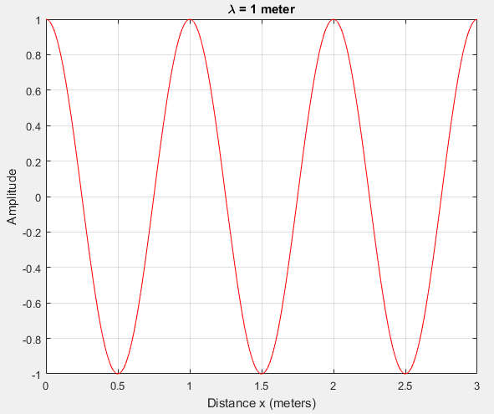
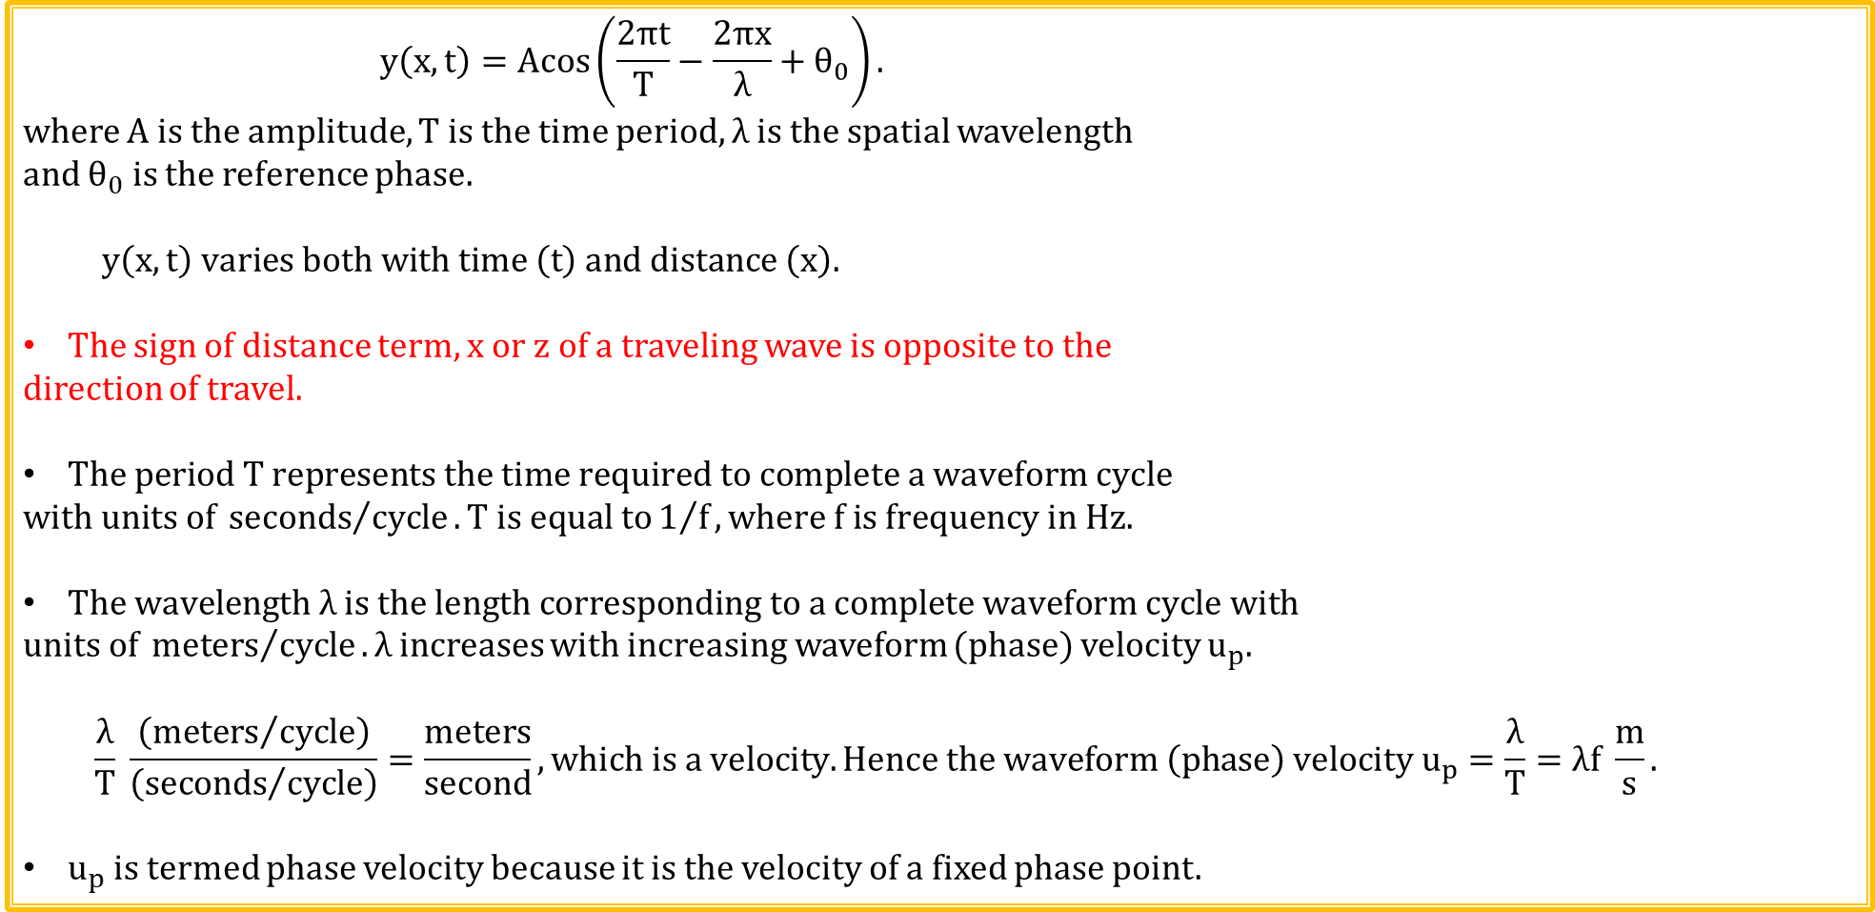
Traveling Sinusoidal Wave in a Lossless Medium
$$y\left(x,t\right)=Acos\left(\frac{2πt}{T}−\frac{2πx}{λ}+θ_{0}\right).$$
where A is the amplitude, T is the time period, λ is the spatial wavelength
and $θ_{0}$ is the reference phase.
$y\left(x,t\right) varies both with time \left(t\right) and distance \left(x\right).$
The sign of distance term, x or z of a traveling wave is opposite to the
direction of travel.
$The period T represents the time required to complete a waveform cycle$
$$with units of{ seconds}/{cycle}. T is equal to1/f, where f is frequency in Hz.$$
$The wavelength λ is the length corresponding to a complete waveform cycle with$
$units of{ meters}/{cycle}. λ$increases with increasing waveform (phase) velocity $u_{p}$.
$$\frac{λ}{T} \frac{\left({meters}/{cycle}\right)}{\left({seconds}/{cycle}\right)}=\frac{meters}{second}, which is a velocity. Hence the waveform \left(phase\right) velocity u_{p}=\frac{λ}{T}=λf \frac{m}{s}.$$
$u_{p}$ is termed phase velocity because it is the velocity of a fixed phase point.

Slide 30
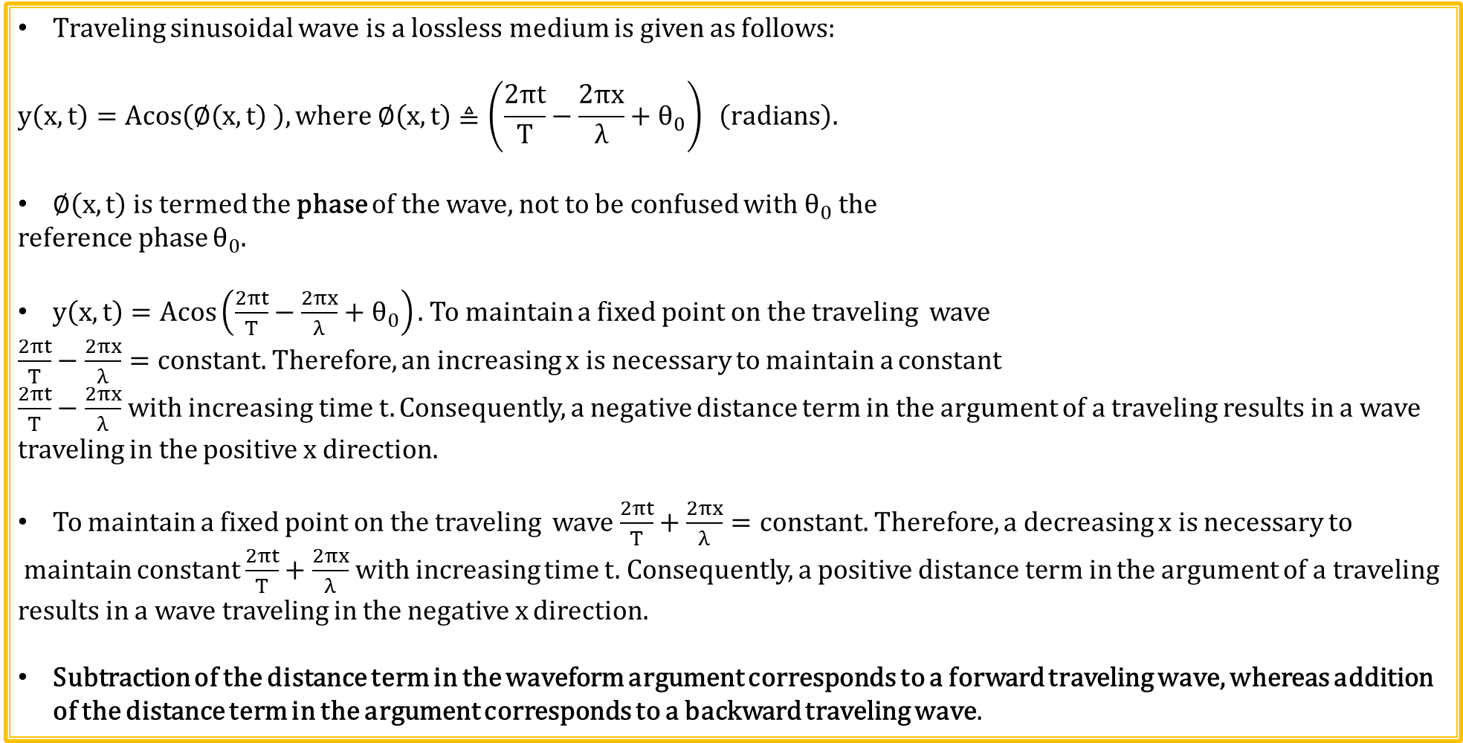
Traveling Sinusoidal Wave in a Lossless Medium (Continued)
Traveling sinusoidal wave is a lossless medium is given as follows:
$$y\left(x,t\right)=Acos\left(∅\left(x,t\right) \right), where ∅\left(x,t\right)≜\left(\frac{2πt}{T}−\frac{2πx}{λ}+θ_{0}\right) \left(radians\right).$$
$∅\left(x,t\right)$ is termed the phase of the wave, not to be confused with $θ_{0}$ the
reference phase $θ_{0}$.
$y\left(x,t\right)=Acos\left(\frac{2πt}{T}−\frac{2πx}{λ}+θ_{0}\right).$ To maintain a fixed point on the traveling wave
$\frac{2πt}{T}−\frac{2πx}{λ}=constant.$Therefore, an increasing x is necessary to maintain a constant
$\frac{2πt}{T}−\frac{2πx}{λ}$with increasing time t. Consequently, a negative distance term in the argument of a traveling results in a wave traveling in the positive x direction.
To maintain a fixed point on the traveling wave $\frac{2πt}{T}+\frac{2πx}{λ}=constant.$Therefore, a decreasing x is necessary to
maintain constant $\frac{2πt}{T}+\frac{2πx}{λ}$with increasing time t. Consequently, a positive distance term in the argument of a traveling results in a wave traveling in the negative x direction.
Subtraction of the distance term in the waveform argument corresponds to a forward traveling wave, whereas addition of the distance term in the argument corresponds to a backward traveling wave.

Slide 31
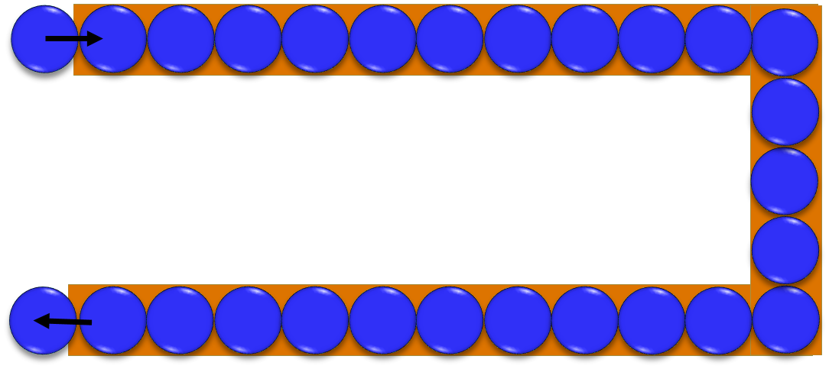
Wave Propagation
AC current propagation along a transmission line, somewhat analogous to a marble track.
Individual marbles don’t move far, but resulting pressure wave travels fast and far.
In an AC transmission line, individual electrons don’t move far, yet resulting wave propagation velocity can approach the speed of light.

Slide 32
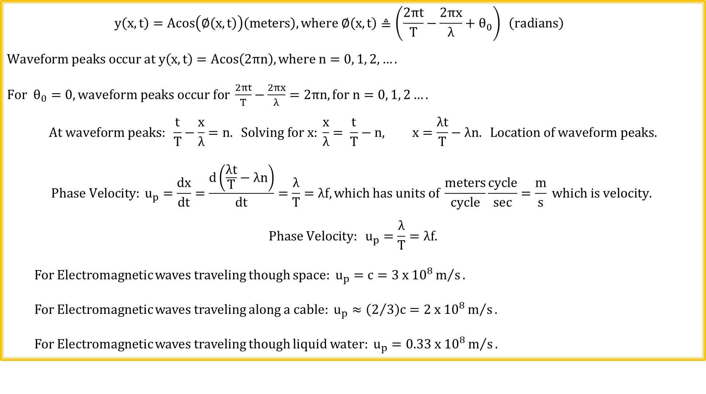
Formal Derivation of Phase Velocity of a Traveling Wave
$$y\left(x,t\right)=Acos\left(∅\left(x,t\right)\right)\left(meters\right),where ∅\left(x,t\right)≜\left(\frac{2πt}{T}−\frac{2πx}{λ}+θ_{0}\right) \left(radians\right)$$
$$Waveform peaks occur at y\left(x,t\right)=Acos\left(2πn\right), where n=0, 1, 2, ….$$
$For$ $θ_{0}=0, waveform peaks occur for \frac{2πt}{T}−\frac{2πx}{λ}=2πn, for n=0, 1, 2….$
$$At waveform peaks: \frac{t}{T}−\frac{x}{λ}=n. Solving for x: \frac{x}{λ}= \frac{t}{T}−n, x=\frac{λt}{T}−λn. Location of waveform peaks.$$
$$Phase Velocity: u_{p}=\frac{dx}{dt}=\frac{d\left(\frac{λt}{T}−λn\right)}{dt}=\frac{λ}{T}=λf, which has units of \frac{meters}{cycle}\frac{cycle}{sec}=\frac{m}{s} which is velocity.$$
$$Phase Velocity: u_{p}=\frac{λ}{T}=λf.$$
For Electromagnetic waves traveling though space: $u_{p}=c=3 x {10}^{8}m/s.$
For Electromagnetic waves traveling along a cable: $u_{p}≈\left(2/3\right)c=2 x {10}^{8}m/s.$
For Electromagnetic waves traveling though liquid water: $u_{p}=0.33 x {10}^{8}m/s.$

Slide 33
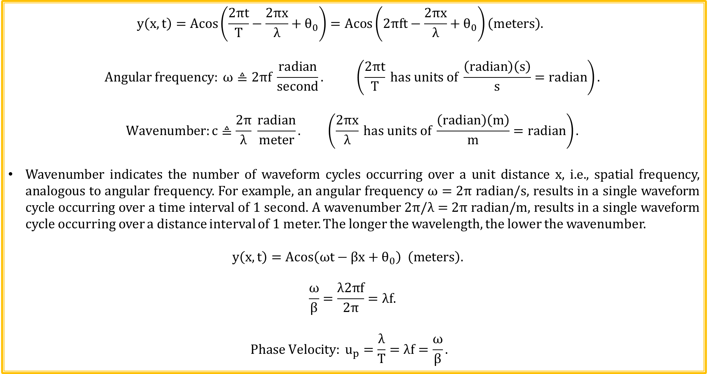
Traveling Sinusoidal Waves in Lossless Medium
$$y\left(x,t\right)=Acos\left(\frac{2πt}{T}−\frac{2πx}{λ}+θ_{0}\right)=Acos\left(2πft−\frac{2πx}{λ}+θ_{0}\right)\left(meters\right).$$
$$Angular frequency: ω≜2πf \frac{radian}{second}. \left(\frac{2πt}{T} has units of \frac{\left(radian\right)\left(s\right)}{s}=radian\right).$$
$$Wavenumber:c≜\frac{2π}{λ} \frac{radian}{meter}. \left(\frac{2πx}{λ} has units of \frac{\left(radian\right)\left(m\right)}{m}=radian\right).$$
Wavenumber indicates the number of waveform cycles occurring over a unit distance x, i.e., spatial frequency, analogous to angular frequency. For example, an angular frequency $ω=$ 2π radian/s, results in a single waveform cycle occurring over a time interval of 1 second. A wavenumber 2π/λ = 2π radian/m, results in a single waveform cycle occurring over a distance interval of 1 meter. The longer the wavelength, the lower the wavenumber.
$$y\left(x,t\right)=Acos\left(ωt−βx+θ_{0}\right) \left(meters\right).$$
$$\frac{ω}{β}=\frac{λ2πf}{2π}=λf.$$
$${Phase Velocity: u}_{p}=\frac{λ}{T}=λf=\frac{ω}{β}.$$

Slide 34
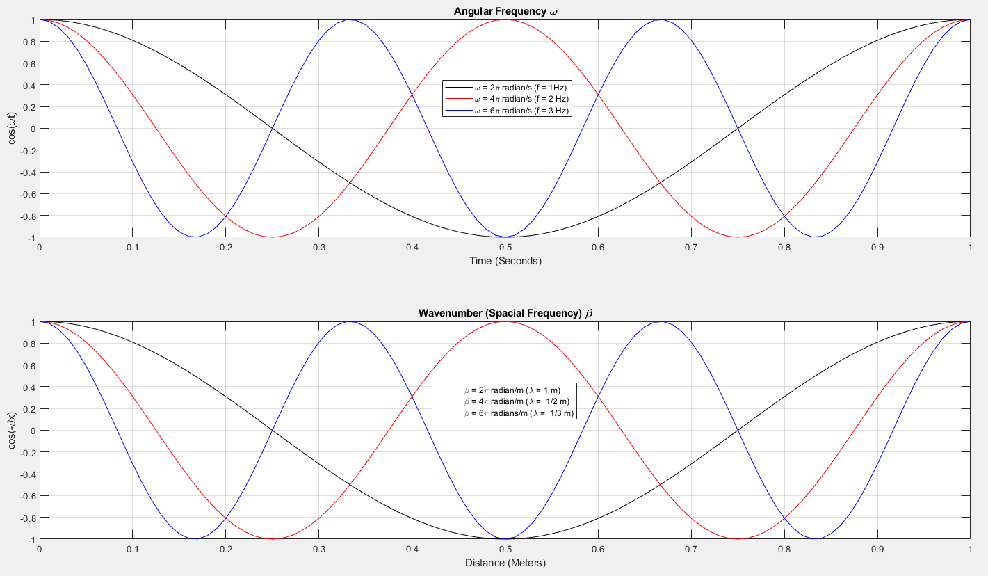
Angular Frequency ω and Wavenumber β

Slide 35
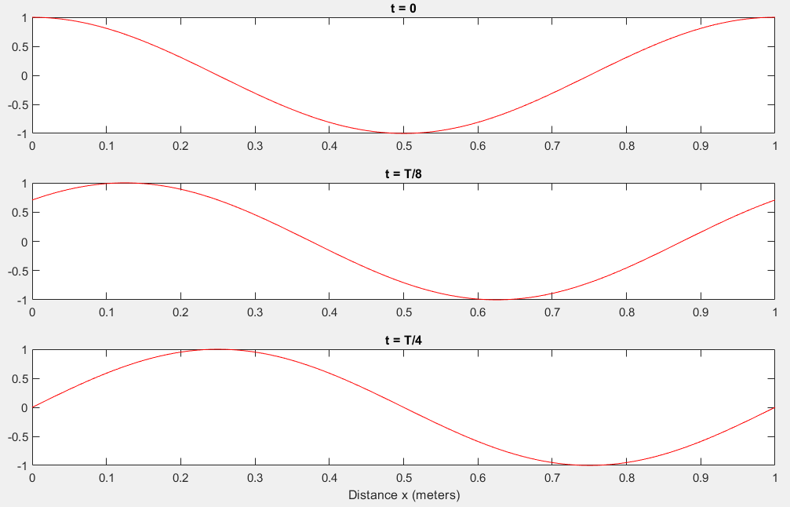
Sinusoidal Voltage Wave Traveling in a Positive x Direction
$y\left(x,t\right)=cos\left(\frac{2πt}{T}−\frac{2πx}{λ}\right) V.$T =1 second, λ = 1 meter, $θ_{0}=0$ radians, Phase Velocity = 1 meter/sec.
Increasing
time

Slide 36
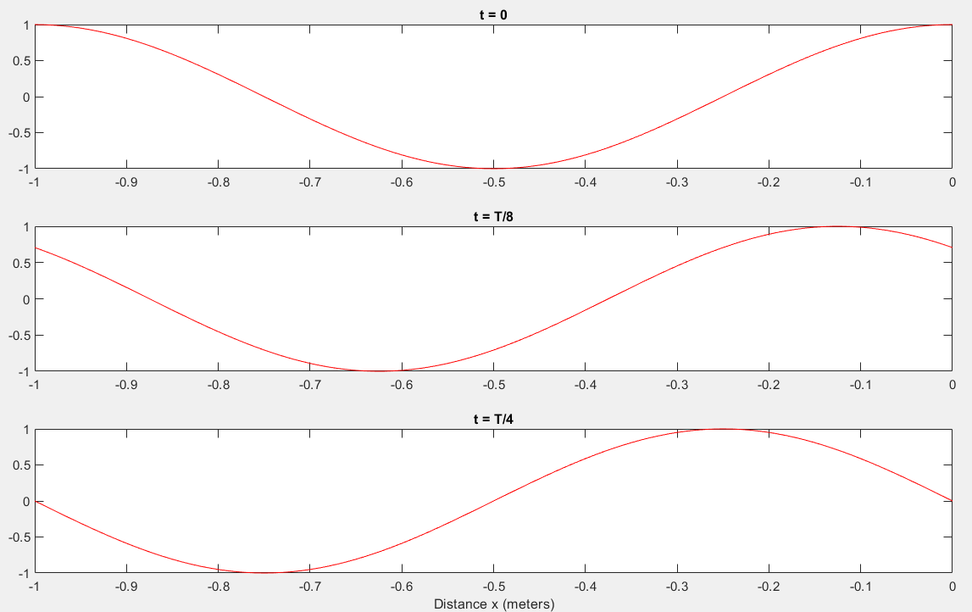
Sinusoidal Voltage Wave Traveling in a Negative x Direction
$y\left(x,t\right)=cos\left(\frac{2πt}{T}+\frac{2πx}{λ}\right) V.$T =1 second, λ = 1 meter, $θ_{0}=0$ radians, Phase Velocity = 1 meter/sec.
Increasing
time

Slide 37
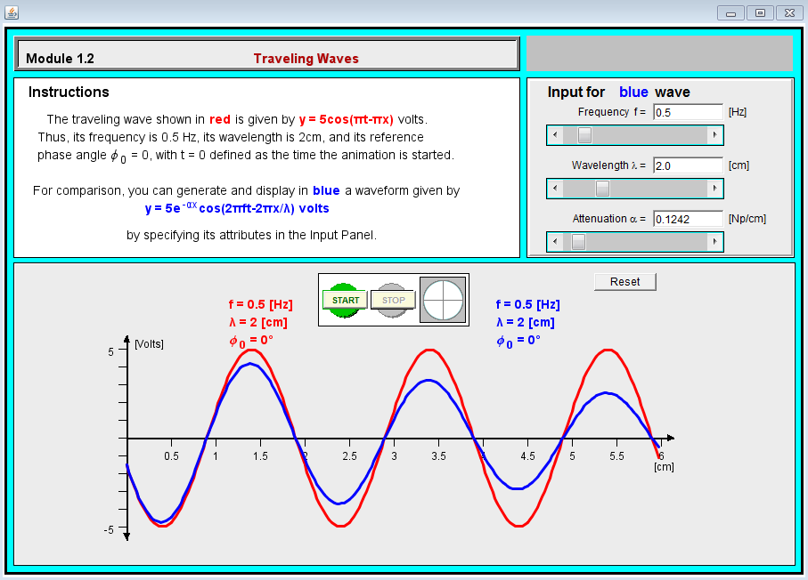
Traveling Waves
Go to Applied Electromagnetics 8E Textbook Website to run the Interactive Modules, located under Student Resources. Click on Chapter 1: Introduction: Waves and Phasors → 1.2 Traveling Waves.
Poll Questions
Notes:
Go to web Fundamentals of Applied Electromagnetics to download Interactive Modules available for the Ulaby – Fundamentals of Applied Electromagnetics text.

Slide 38
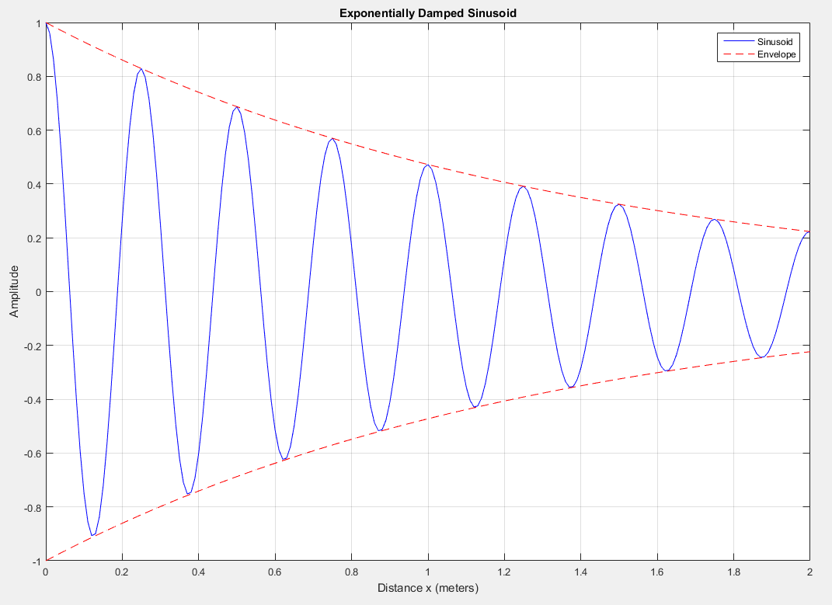
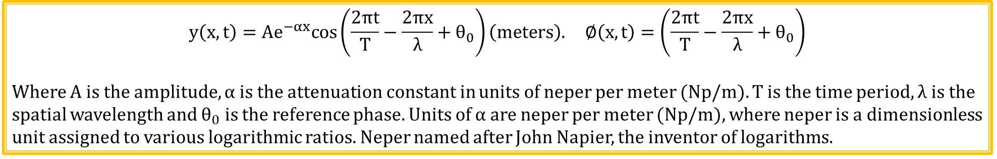
Traveling Sinusoidal Wave in a Lossy Medium
$$y\left(x,t\right)=Ae^{−αx}cos\left(\frac{2πt}{T}−\frac{2πx}{λ}+θ_{0}\right)\left(meters\right). ∅\left(x,t\right)=\left(\frac{2πt}{T}−\frac{2πx}{λ}+θ_{0}\right)$$
Where A is the amplitude, α is the attenuation constant in units of neper per meter (Np/m). T is the time period, λ is the spatial wavelength and $θ_{0}$ is the reference phase. Units of α are neper per meter (Np/m), where neper is a dimensionless unit assigned to various logarithmic ratios. Neper named after John Napier, the inventor of logarithms.

Slide 39
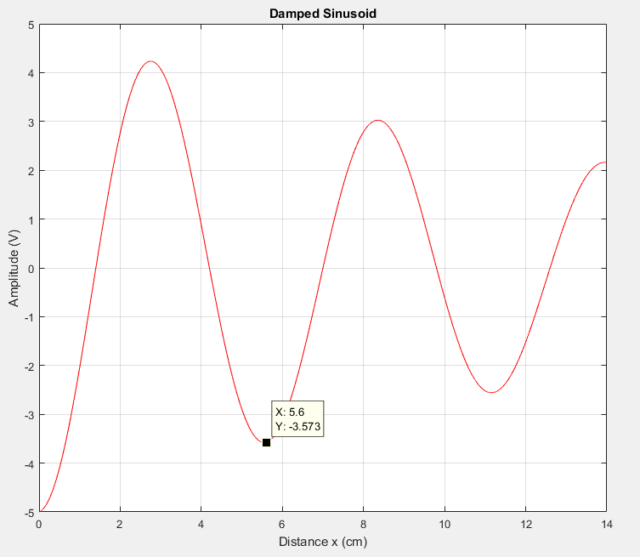
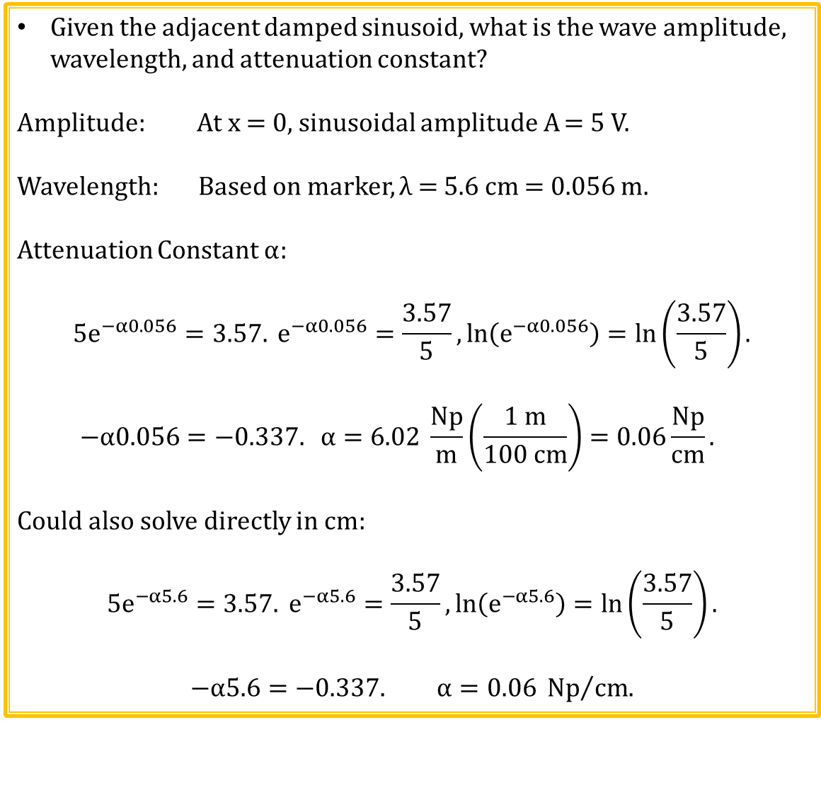
Damped Sinusoidal Example 1
Given the adjacent damped sinusoid, what is the wave amplitude, wavelength, and attenuation constant?
Amplitude: At x = 0, sinusoidal amplitude A = 5 V.
Wavelength: Based on marker, λ = 5.6 cm = 0.056 m.
Attenuation Constant α:
$$5e^{−α0.056}=3.57. e^{−α0.056}=\frac{3.57}{5},\ln\left(e^{−α0.056}\right)=\ln\left(\frac{3.57}{5}\right).$$
$$−α0.056=−0.337. α=6.02 \frac{Np}{m}\left(\frac{1 m}{100 cm}\right)=0.06\frac{Np}{cm}.$$
Could also solve directly in cm:
$$5e^{−α5.6}=3.57. e^{−α5.6}=\frac{3.57}{5},\ln\left(e^{−α5.6}\right)=\ln\left(\frac{3.57}{5}\right).$$
$$−α5.6=−0.337. α=0.06 {Np}/{cm.}$$

Slide 40
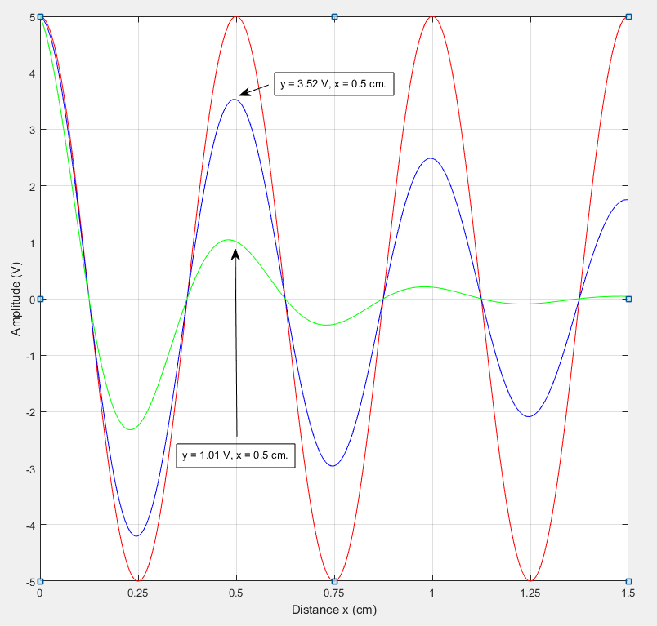
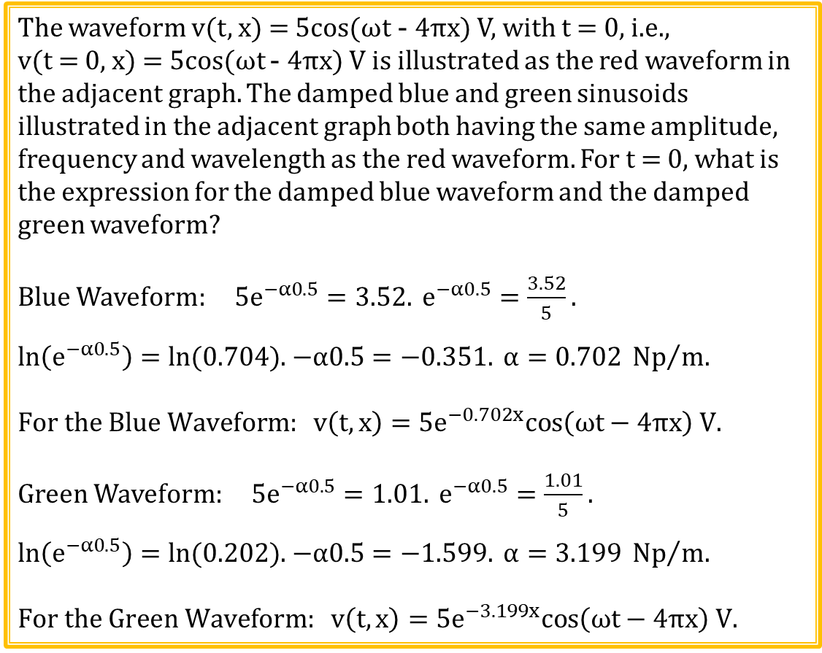
Damped Sinusoidal Example 2
The waveform v(t, x) = 5cos(ωt - 4πx) V, with t = 0, i.e.,
v(t = 0, x) = 5cos(ωt - 4πx) V is illustrated as the red waveform in the adjacent graph. The damped blue and green sinusoids illustrated in the adjacent graph both having the same amplitude, frequency and wavelength as the red waveform. For t = 0, what is the expression for the damped blue waveform and the damped green waveform?
Blue Waveform: $5e^{−α0.5}=3.52. e^{−α0.5}=\frac{3.52}{5}.$
$\ln\left(e^{−α0.5}\right)=ln⁡(0.704)$. $−α0.5=−0.351. α=0.702 {Np}/m$.
$$For the Blue Waveform: v\left(t, x\right)=5e^{−0.702x}cos\left(\text{ω}\text{t}−4πx\right) V.$$
Green Waveform: $5e^{−α0.5}=1.01. e^{−α0.5}=\frac{1.01}{5}.$
$\ln\left(e^{−α0.5}\right)=ln⁡(0.202)$. $−α0.5=−1.599. α=3.199 {Np}/m$.
$$For the Green Waveform: v\left(t, x\right)=5e^{−3.199x}cos\left(\text{ω}\text{t}−4πx\right) V.$$

Slide 41
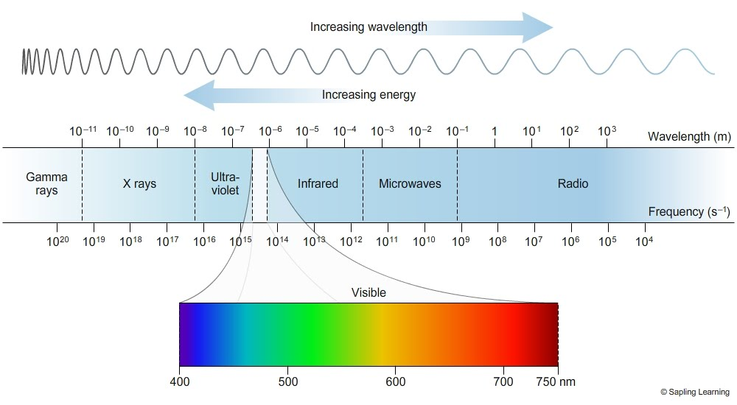
Electromagnetic Spectrum
White light consists of all wavelengths of visible light.

Slide 42
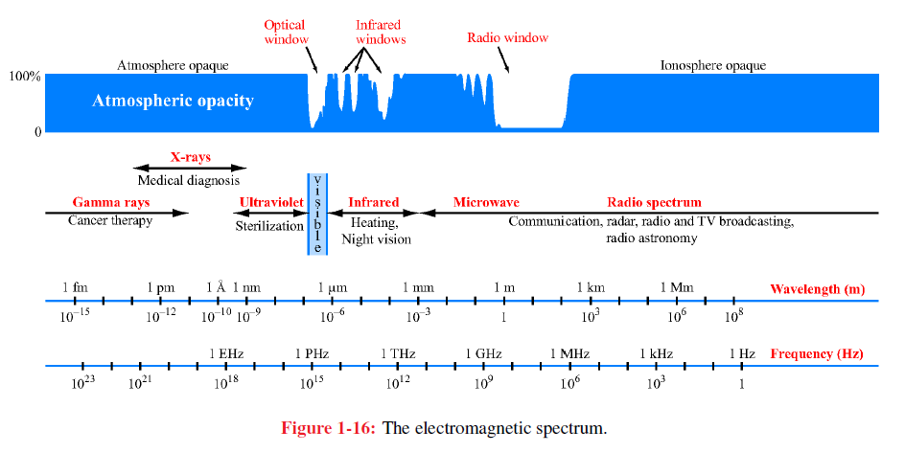
Electromagnetic Spectrum
100% Opacity means that it is impenetrable to the associated EM radiation.

Slide 43
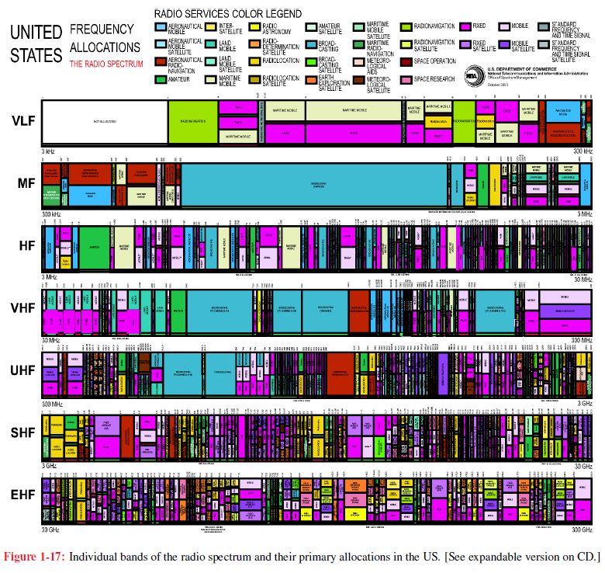
US Frequency Allocation Chart
The EM Spectrum is considered a natural resource with strict FCC control over the usage of this resource.

Slide 44
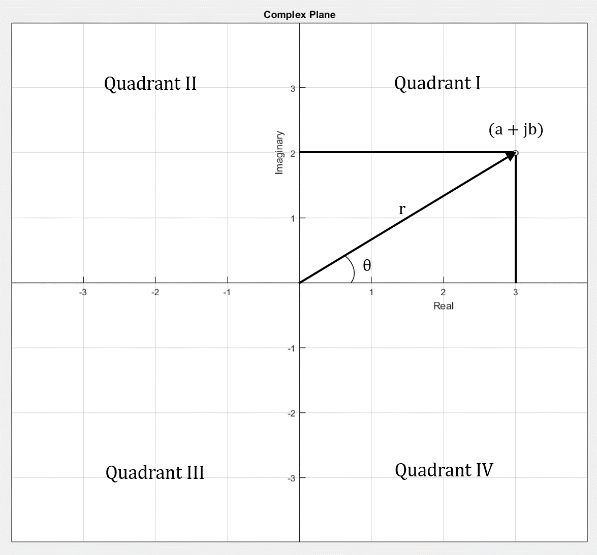

Cartesian (Rectangular) and Polar Coordinates
Cartesian (Rectangular) Coordinates: a + jb.
Polar Coordinates: (r, θ).
Rectangular to Polar: (a + jb) → (r, θ)
$$r=\sqrt{a^{2}+b^{2}} .$$
$$θ= \tan^{−1}\left(\frac{Imaginary}{Real}\right)= \tan^{−1}\left(\frac{b}{a}\right).$$
Results from inverse tangent are either
located in Quadrants I or IV, never quadrants
II or III. Positive (b/a) argument results in θ
for Quadrant I. Negative (b/a) argument
results in θ for Quadrant IV.
Have to add 180˚ to resulting angle when converting from rectangular to polar, if result should be in Quadrant II or III, which occurs for a < 0.
MATLAB atan2() function is a special 4-Quadrant inverse tangent function that eliminates need to add 180˚ for quadrant correction. Theta = atan2(b, a);

Slide 45
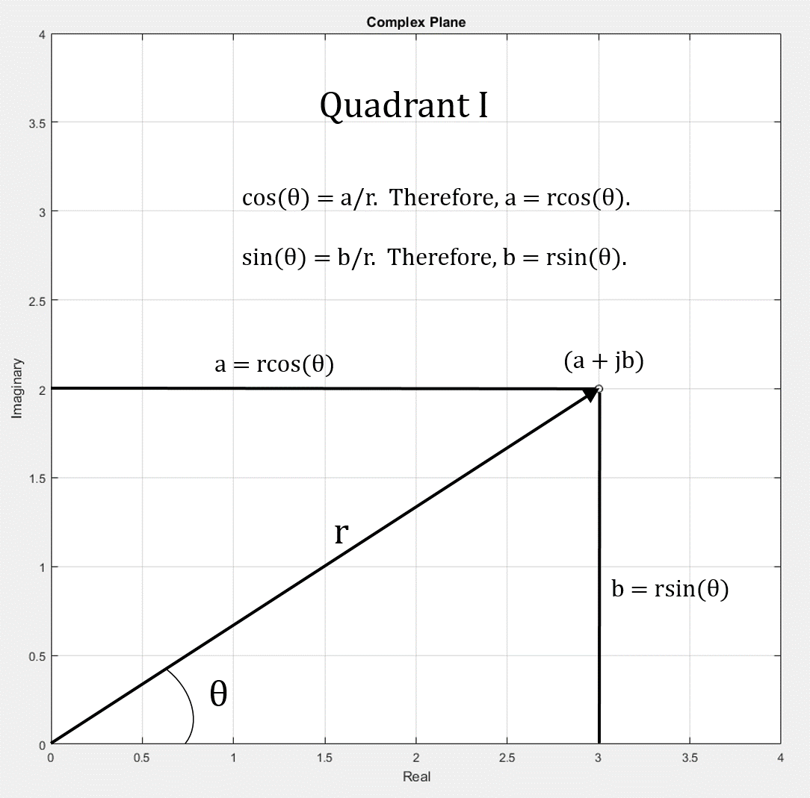
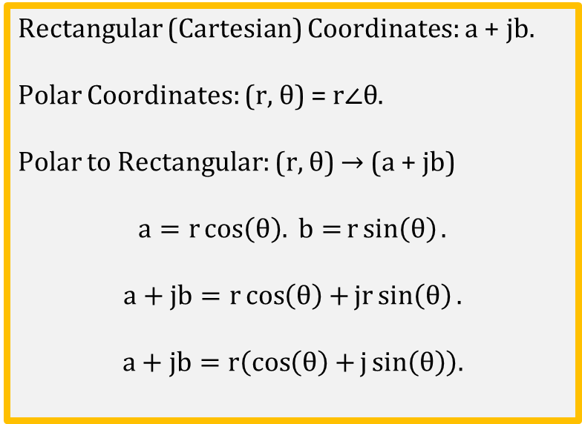
Cartesian (Rectangular) and Polar Coordinates
Rectangular (Cartesian) Coordinates: a + jb.
Polar Coordinates: (r, θ) = $r∠θ$.
Polar to Rectangular: (r, θ) → (a + jb)
$$a=r\cos\left(θ\right). b=r\sin\left(θ\right).$$
$$a+jb=r\cos\left(θ\right)+jr\sin\left(θ\right).$$
$$a+jb=r\left(\cos\left(θ\right)+j\sin\left(θ\right)\right).$$

Slide 46
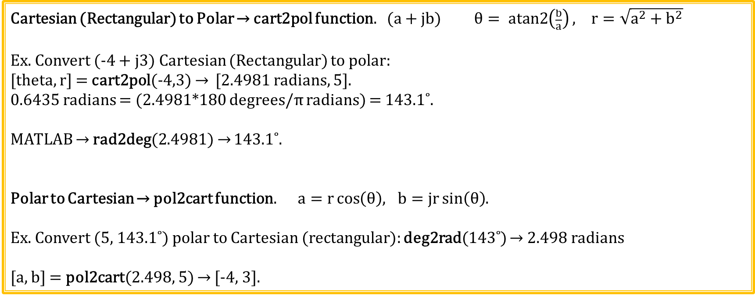
MATLAB Cartesian (Rectangular) and Polar Coordinate Conversions
Cartesian (Rectangular) to Polar → cart2pol function. (a + jb) $θ= atan2\left(\frac{b}{a}\right), r=\sqrt{a^{2}+b^{2}}$
Ex. Convert (-4 + j3) Cartesian (Rectangular) to polar:
[theta, r] = cart2pol(-4,3) → [2.4981 radians, 5].
0.6435 radians = (2.4981*180 degrees/π radians) = 143.1˚.
MATLAB → rad2deg(2.4981) → 143.1˚.
Polar to Cartesian → pol2cart function. $a=r\cos\left(θ\right){, b=jr\sin\left(θ\right)}$.
Ex. Convert (5, 143.1˚) polar to Cartesian (rectangular): deg2rad(143˚) → 2.498 radians
[a, b] = pol2cart(2.498, 5) → [-4, 3].

Slide 47
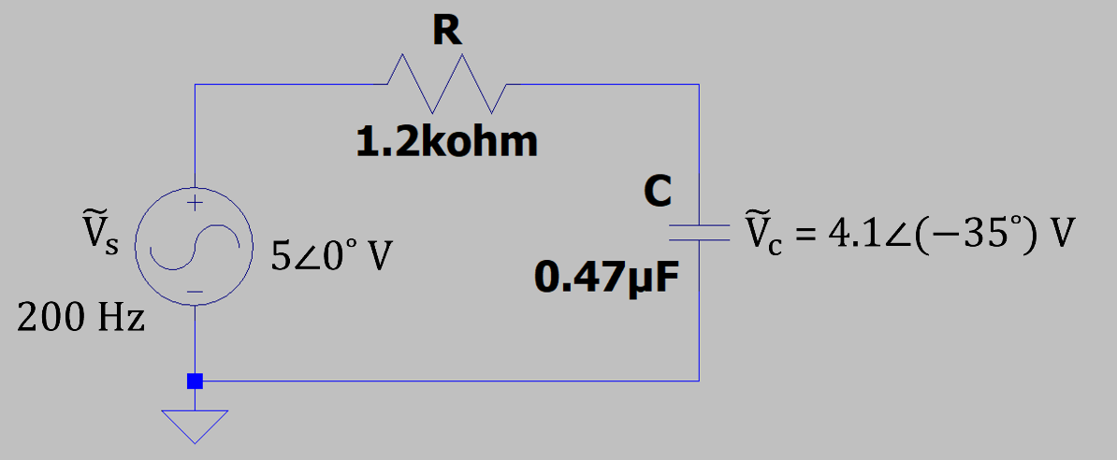



AC Steady-State and Phasors
For AC steady-state at a given frequency, the
amplitude and phase angle difference between ${\tilde{V}}_{s}$
and ${\tilde{V}}_{c}$is a constant in the above circuit.
A complex number, referred to as a phasor,
is used to denote this constant peak amplitude
(magnitude) and phase angle difference between
${\tilde{V}}_{s}$and ${\tilde{V}}_{c}$at the given frequency.
Phasors are not a function of time, since for
steady-state the constant peak amplitude (magnitude)
and phase angle difference between ${\tilde{V}}_{s}$and ${\tilde{V}}_{c}$is not a function of time.
Need Euler’s formula to arrive at a mathematical expression for phasors.

Slide 48

Series Expansion for e^{θ}
$$Series Expansions: e^{θ}=1+θ+ \frac{θ^{2}}{2!}+\frac{θ^{3}}{3!}+\frac{θ^{4}}{4!}+\frac{θ^{5}}{5!}+\frac{θ^{6}}{6!}…=1+θ+ \frac{θ^{2}}{2}+\frac{θ^{3}}{6}+\frac{θ^{4}}{24}+\frac{θ^{5}}{120}+\frac{θ^{6}}{720}…$$
$$e^{θ} approches ∞ as θ approaches ∞.$$
Imaginary Operator j:
$j= \sqrt{−1}.$
$j^{2}=−1.$
$j^{3}=−j.$
$j^{4}=1.$
$j^{5}=j.$
$j^{6}=−1.$
j^{2n} = (-1)^{n}, alternating between ±1. j^{2n+1} alternates between ∓j.
$$e^{jθ}=1+jθ+ \frac{{\left(jθ\right)}^{2}}{2!}+\frac{{\left(jθ\right)}^{3}}{3!}+\frac{{\left(jθ\right)}^{4}}{4!}+\frac{{\left(jθ\right)}^{5}}{5!}+\frac{{\left(jθ\right)}^{6}}{6!}…=1+jθ−\frac{θ^{2}}{2}−j\frac{θ^{3}}{6}+\frac{θ^{4}}{24}+j\frac{θ^{5}}{120}−\frac{θ^{6}}{720}…$$
$$e^{jθ}=\left(1−\frac{θ^{2}}{2}+\frac{θ^{4}}{24}−\frac{θ^{6}}{720}+…\right)+j\left(θ−\frac{θ^{3}}{6}+\frac{θ^{5}}{120}−…\right). Complex number as expected.$$
$$\left|e^{jθ}\right| does not approch ∞, as θ approaches ∞, because of cancellation of positive and negative terms.$$

Slide 49

Euler’s Formula
$$Series Expansions: e^{θ}=1+θ+ \frac{θ^{2}}{2!}+\frac{θ^{3}}{3!}+\frac{θ^{4}}{4!}… =1+θ+ \frac{θ^{2}}{2}+\frac{θ^{3}}{6}+\frac{θ^{4}}{24}…$$
$$\cos\left(θ\right)=1− \frac{θ^{2}}{2!}+\frac{θ^{4}}{4!}−\frac{θ^{6}}{6!}…=1− \frac{θ^{2}}{2}+\frac{θ^{4}}{24}−\frac{θ^{6}}{720}….For θ=0˚,\cos\left(θ\right)=1.$$
$$\sin\left(θ\right)=θ− \frac{θ^{3}}{3!}+\frac{θ^{5}}{5!}−\frac{θ^{7}}{7!}… =θ− \frac{θ^{3}}{6}+\frac{θ^{5}}{120}−\frac{θ^{7}}{5040}…. For θ=0˚,\sin\left(θ\right)=0.$$
$$e^{jθ}=1+jθ+ \frac{{\left(jθ\right)}^{2}}{2!}+\frac{{\left(jθ\right)}^{3}}{3!}+\frac{{\left(jθ\right)}^{4}}{4!}…=\left(1− \frac{θ^{2}}{2!}+\frac{θ^{4}}{4!}−\frac{θ^{6}}{6!}…\right)+j\left(θ− \frac{θ^{3}}{3!}+\frac{θ^{5}}{5!}−\frac{θ^{7}}{7!}…\right).$$
${{Euler}^{′}s Formula: e}^{jθ}=\cos\left(θ\right)+\operatorname{jsin}\left(θ\right)→$ Complex exponentials and sinusoids are related.
$$Magnitude of\cos\left(θ\right)+\operatorname{jsin}\left(θ\right)=\sqrt{\cos^{2}\left(θ\right)+\sin^{2}\left(θ\right)}.$$
$$Trig Identity: \sin^{2}\left(θ\right)+\cos^{2}\left(θ\right)=1. Therefore, the magnitude\cos\left(θ\right)+\operatorname{jsin}\left(θ\right)always equals 1.$$
$$Angle of\cos\left(θ\right)+\operatorname{jsin}\left(θ\right)=\tan^{−1}\left(\frac{\sin\left(θ\right)}{\cos\left(θ\right)}\right). Trig Identity: \tan\left(θ\right)=\frac{\sin\left(θ\right)}{\cos\left(θ\right)}.$$
Angle of cos(θ) + jsin(θ) = tan⁻¹(tan(θ)) = θ. Therefore, the angle of cos(θ) + jsin(θ)= θ.

Slide 50

Euler’s Formula and Signal Representation
${{Euler}^{′}s Formula: e}^{jθ}=\cos\left(θ\right)+\operatorname{jsin}\left(θ\right)$.
$$The magnitude\cos\left(θ\right)+\operatorname{jsin}\left(θ\right)always equals 1.The angle of\cos\left(θ\right)+\operatorname{jsin}\left(θ\right)equals θ.$$
$${re}^{jθ} is equivalent to r∠θ which is equivalent to\operatorname{rcos}\left(θ\right)+\operatorname{jrsin}\left(θ\right).$$
$$e^{jωt}=\cos\left(ωt\right)+\operatorname{jsin}\left(ωt\right).$$
$e^{jωt}=\cos\left(ωt\right)+\operatorname{jsin}\left(ωt\right) →$ Counter-Clockwise Rotating Vector for increasing $ωt$.
Magnitude of ($e^{jωt}$) = 1 for all $ωt$. Angle of ($e^{jωt}$) = $ωt$.
Magnitude of (${re}^{jωt}$) = r for all $ωt$. Angle of (${re}^{jωt}$) = $ωt$.
$$Represent real signals as follows: v\left(t\right)=r\cos\left(ωt+θ_{0}\right)=ℛe\left\{{re}^{j\left(ωt+θ_{0}\right)}\right\}.$$
Imaginary (r$sinωt)$
$$re^{jωt}=rcosωt+jrsinωt$$
$$ωt$$
r
rsinωt
ωt
rcosωt
Real $(rcosωt$)
Rotating Phasor Animation

Slide 51

Phasor Signal Representation
$$Represent a cosine wave as follows: v\left(t\right)=r\cos\left(ωt+∅\right)=ℛe\left\{{re}^{j\left(ωt+∅\right)}\right\}.$$
$${re}^{j\left(ωt+∅\right)}={re}^{j∅}e^{jωt}.$$
$$v\left(t\right)=ℛe\left\{{re}^{j∅}e^{jωt}\right\}.$$
$Define \tilde{V}= {re}^{j∅}$ $→$ Referred to as a phasor, i.e., phase vector.
Different spelling that Star Trek Phaser.
Phasors are complex quantities that are not a function of time.
Phasors are used in ac steady-state analysis having a single common frequency.
${re}^{j∅}$ ↔ $r∠∅→Phasor Notation.$ (Note: r is to always be a positive number.)
$Then v\left(t\right)=ℛe\left\{{\tilde{V}e}^{jωt}\right\}.$ Where phasor $\tilde{V}= {re}^{j∅}$.

Slide 52

Phasor Examples
1. Find the phasor representations of the following time function: v(t) = 12cos(ωt + π/4) V.
$v\left(t\right)= ℛe\left\{12e^{j\left(ωt+π/4\right)}\right\}=ℛe\left\{12e^{jπ/4}e^{jωt}\right\}=ℛe\left\{{\tilde{V}e}^{jωt}\right\}. \tilde{V}=12e^{jπ/4}.$
2. Find the phasor representations of the following time function: v(t) = 12sin(ωt) V.
Need cosine reference. $sin\left(x\right)=cos\left(π/2−x\right). Also\cos\left(−x\right)=cos\left(x\right).$
$$So sin\left(x\right)=cos\left(π/2−x\right)=cos\left({x−π}/2\right).$$
$$sin\left(ωt\right)=\cos\left(ωt−π/2\right).$$
$$v\left(t\right)= 12cos(ωt−π/{2)}=ℛe\left\{12e^{j\left(ωt−π/2\right)}\right\}=ℛe\left\{12e^{−jπ/2}e^{jωt}\right\}=ℛe\left\{\tilde{V}e^{jωt}\right\}.$$
$\tilde{V} =12e^{−jπ/2}.$

Slide 53

Phasor Representation of Traveling Waves
$$Lossless Traveling Wave: v\left(x,t\right)=Acos\left(ωt−βx\right), where u_{p}=\frac{ω}{β}=\frac{2πf}{{2π}/λ}=λf=\frac{λ}{T}.$$
$Acos\left(ωt+βx\right)$ represents a wave traveling in the –x direction, whereas $Acos\left(ωt−βx\right)$ represents a wave traveling in the positive x direction.
$$v\left(x,t\right)=Acos\left(ωt−βx\right)=ℛe\left\{Ae^{j\left(ωt−βx\right)}\right\}=ℛe\left\{Ae^{−jβx}e^{jωt}\right\}=ℛe\left\{\tilde{V}e^{jωt}\right\}.$$
$Phasor representation of v\left(x,t\right)=Acos\left(ωt−βx\right) is Ae^{−jβx}.$ What does this mean?
$$e^{−jβx}=\cos\left(βx\right)−\operatorname{jsin}\left(βx\right) and accounts for phasor amplitude variation with distance x.$$
Phasor $\tilde{V}\left(x\right)$ has a magnitude of A at x = 0, with the phasor magnitude varying with distance x. So at the instant in time when v(0, t) is equal to A, the voltage along the traveling wave varies as $e^{−jβx}.$
The sign of distance term, x or z, in the exponential of the phasor representation of a traveling wave is opposite to the direction of travel.
Phasor $Ae^{jβx}$ represents a wave traveling in the –x direction, whereas phasor $Ae^{−jβx}$ represents a wave traveling in the positive x direction.

Slide 54

Phasor Relationships
$For v\left(t\right)=ℛe\left\{\tilde{V}e^{jωt}\right\}, \frac{dv(t)}{dt}=ℛe\left\{{\frac{d}{dt}(\tilde{V}e}^{jωt})\right\}=ℛe\left\{{\tilde{V}\frac{d}{dt}e}^{jωt})\right\}=ℛe\left\{{jω\tilde{V}e}^{jωt}\right\}.$
$\frac{dv(t)}{dt}=ℛe\left\{{jω\tilde{V}e}^{jωt}\right\}.$Multiply by jω for differentiation.
$$\frac{dv(t)}{dt}↔jω\tilde{V}. Differentiation in the time domain is equivalent to multiplying by jω in the phasor domain.$$
$For v\left(t\right)=ℛe\left\{{\tilde{V}e}^{jωt}\right\}, \int{v\left(t\right)dt}=ℛe\left\{\int{\tilde{V}e^{jωt}dt}\right\}=ℛe\left\{\tilde{V}\int{e^{jωt}dt}\right\}=ℛe\left\{{\tilde{V}\left(1/{jω}\right)e}^{jωt}\right\}.$
$\int{v\left(t\right)dt}=ℛe\left\{{\left(1/{jω}\right)\tilde{V}e}^{jωt}\right\}.$ Divide by jω for integration.
$$\int{v\left(t\right)dt}↔\left(1/{jω}\right)\tilde{V}. Integration in the time domain is equivalent to dividing by jω in the phasor domain.$$
Phasors turn differential equations in the time domain into algebraic equations in the phasor domain.
Phasors are a particular case of the Laplace Transform with s = jω.
$Phasor Multiplication:\left(a∠θ\right)\left(b∠∅\right)=\left(a\right)\left(b\right)∠\left(θ+∅\right). Phasor Division: \frac{a∠θ}{b∠∅}=\frac{a}{b}∠\left(θ−∅\right).$

Slide 55

Phasors and Impedance
$$\frac{dv(t)}{dt}↔jω\tilde{V}. \int{v\left(t\right)dt}↔\left(1/{jω}\right)\tilde{V}.$$
For an inductor: $v_{L}\left(t\right)=L\frac{{di}_{L}\left(t\right)}{dt}$. In terms of phasors, ${\tilde{V}}_{L}=Ljω{\tilde{I}}_{L}.$
Define inductor impedance Z_{L} as phasor voltage divided by phasor current.
$$Z_{L}=\frac{{\tilde{V}}_{L}}{{\tilde{I}}_{L}}=jωL. {Also, Z}_{L}={jX}_{L}=X_{L}∠90°, where X_{L}≜ ωL, referred to as inductive reactance.$$
For a capacitor: $I_{C}\left(t\right)=C\frac{{dV}_{C}\left(t\right)}{dt}$. In terms of phasors, ${\tilde{I}}_{C}=Cjω{\tilde{V}}_{C}.$
Define capacitor impedance Z_{C} as phasor voltage divided by phasor current.
$$Z_{C}=\frac{{\tilde{V}}_{C}}{{\tilde{I}}_{C}}=\frac{1}{jωC}.{ Also, Z}_{C}={−jX}_{C} =X_{C}∠\left(−90°\right),where X_{C}≜ 1/{ωC}, referred to as capacitive reactance\text{.}$$
Impedance Z is a complex number representing the magnitude of peak phasor voltage divided by peak phasor current, along with the phase angle difference between voltage and current.

Slide 56



Phasor Relationship for Resistors
For a resistor: $v_{R}\left(t\right)=i_{R}\left(t\right)R$. For $v_{R}\left(t\right)=V_{m}cos\left(2πft\right),$where V_{m} is the peak amplitude of the cosine wave.
$i_{R}\left(t\right)=\left({V_{m}}/R\right)cos\left(ωt\right)=I_{m}cos\left(ωt\right),$ where I_{m} is the peak amplitude of the cosine wave.
In terms of phasors, ${\tilde{V}}_{R}=V_{m}∠0˚ and {\tilde{I}}_{R}=I_{m}∠0˚.$
For a circuit having pure resistance the voltage and current have the same phase.

Slide 57




Phasor Relationship for Inductors
Inductors oppose a change in current.
$$For an inductor:V_{L}\left(t\right)=L\frac{{dI}_{L}\left(t\right)}{dt}. \frac{dI_{L}(t)}{dt}↔jω{\tilde{I}}_{L}. In terms of phasors,{\tilde{V}}_{L}=jωL{\tilde{I}}_{L}.$$
$e^{j90˚}=\cos\left(90˚\right)+\operatorname{jsin}\left(90˚\right)$ = 0 + j = j. So ${j=e}^{j90˚}$.
Multiplying by j results in +90˚ phase shift, meaning ${\tilde{V}}_{L} leads {\tilde{I}}_{L}$by 90˚.
$$So {\tilde{V}}_{L} leads {\tilde{I}}_{L} by 90˚ in the circuit below.$$
$$Inductor voltage is in phase with the signal generator voltage in circuit below.$$
$${\tilde{V}}_{L} =V_{m}∠0˚.{\tilde{I}}_{L}=I_{m}∠\left(−90˚\right), where V_{m} and I_{m} are peak values of the corresponding sinusoids.$$
Imaginary
Inductor Voltage Always Leads Inductor Current
by 90˚.
$${\tilde{V}}_{L}$$
Real
-90˚
$${\tilde{I}}_{L}$$

Slide 58




Phasor Relationship for Capacitors
Capacitors oppose a change in voltage.
$$For a capacitor: I_{C}\left(t\right)=C\frac{{dV}_{C}\left(t\right)}{dt}. \frac{dV_{C}(t)}{dt}↔jω{\tilde{V}}_{C}. In terms of phasors,{\tilde{I}}_{C}=jωC{\tilde{V}}_{C}.$$
$e^{j90˚}=\cos\left(90˚\right)+\operatorname{jsin}\left(90˚\right)$ = 0 + j = j. So ${j=e}^{j90˚}$.
Multiplying by j results in +90˚ phase shift, meaning ${\tilde{I}}_{C} leads {\tilde{V}}_{C}$by 90˚.
$$So {\tilde{I}}_{C} leads {\tilde{V}}_{C} by 90˚ in the circuit below.$$
$$Capacitor voltage is in phase with signal generator voltage in the circuit below.$$
$${\tilde{V}}_{C}=V_{m}∠0˚.{\tilde{I}}_{C}=I_{m}∠90˚, where V_{m} and I_{m} are peak values of the corresponding sinusoids.$$
Imaginary
Capacitor Current Always Leads
Capacitor Voltage by 90˚.
$${\tilde{I}}_{C}$$
90˚
$${\tilde{V}}_{C}$$
Real

Slide 59




Time Derivatives and Phasors
Adjacent blue cosine wave changes most rapidly at zero crossings,
and has zero change at positive and negative peak values.
$$\frac{d\left[cos\left(2πft\right)\right]}{dt}=\left(−2πf\right)sin\left(2πft\right).$$
Resulting time derivative of the cosine wave leads the original
cosine wave by π/2 or 90˚, and has larger peak magnitude by
the factor of 2πf.
Derivative of a sine wave leads the sine wave by π/2 or 90˚ also,
and has larger peak magnitude by the factor of 2πf.
The associated amplitude of the time derivative of a sinusoid
increases with increasing frequency.
Capacitor current leads capacitor voltage in adjacent circuit
$$because I_{C}\left(t\right)=C\frac{{dV}_{C}\left(t\right)}{dt}. I_{C}\left(t\right) also increases with increasing f.$$
Inductor voltage leads inductor current in adjacent circuit
because $V_{L}\left(t\right)=L\frac{{dI}_{L}\left(t\right)}{dt}$. $V_{L}\left(t\right) also increases with increasing f$.
$$V_{C}\left(t\right) equals$$
$$app\text{lied} \text{voltage}\text{.}$$
${ V}_{L}\left(t\right)$ $equals$
$$app\text{lied} \text{voltage}\text{.}$$

Slide 60


Reactance – Magnitude of Impedance
$$Impedance of a Capacitor: Z_{C}=\frac{1}{jωC}=−jX_{C}.$$
$$Capacitive Reactance: X_{C}=\frac{V_{m}}{I_{m}}=\frac{1}{2πfC}.$$
$X_{C}=∞, at f=0, and 0 at f=∞.$
Capacitors look like an open at DC, and a short
at high-frequency AC.
$$Impedance of an Inductor: Z_{L}=jωL=jX_{L}.$$
$$Inductive Reactance:X_{L}=\frac{V_{m}}{I_{m}}=2πfL.$$
$X_{L}=0, at f=0, and ∞ at f=∞.$
Inductors look like a short at DC, and an open
at high-frequency AC.

Slide 61


Phasor RC Example 1
A series-connected RC circuit with R = 1.2 kΩ and
C = 0.47 µF is connected to a 5 V peak, sinusoidal
200 Hz source. Determine the overall impedance,
i.e., Z_{eq}, along with the phasor circuit current $\tilde{I}$, the
phasor resistor voltage ${\tilde{V}}_{R}$, and the phasor capacitor
voltage ${\tilde{V}}_{C}$.
X_{C} = 1/(2πfC) = 1/[2π(200 Hz)(0.47 µF)] = 1.69 kΩ. X_{C} = 1.69 kΩ.
$Z_{C}=1.69∠\left(−90˚\right) kΩ$ = 0 - j$1.69 kΩ$.
$Z_{eq}=$ R – jX_{C} = 1.2 kΩ - j$1.69 kΩ$.
$\left|Z_{eq}\right|=\sqrt{R^{2}+{X_{c}}^{2}}=\sqrt{{\left(1.2 kΩ\right)}^{2}+{\left(1.69 kΩ\right)}^{2}}=2.08 kΩ$. $\left|Z_{eq}\right|=2.08 kΩ$.
$∅_{eq}=\tan^{−1}\left({{−X}_{c}}/R\right)=\tan^{−1}\left[{\left(−1.69 kΩ\right)}/{\left(1.2 kΩ\right)}\right]=−54.6˚. ∅_{eq}=−54.6˚$.
Z_{eq} $=2.08∠\left(−54.6˚\right)$ $kΩ, also sometimes represented as 2.08 kΩ∠\left(−54.6˚\right)\text{.}$ (Continued on next slide).
Poll Questions

Slide 62




Phasor RC Example 1 (Continued)
$\text{Z}\text{eq}=2.08∠\left(−54.6˚\right) kΩ.$ From previous slide.
$\tilde{I}={{\tilde{V}}_{S}}/{Z_{eq}}={\left(5∠0˚ V\right)}/{\left(2.08∠\left(−54.6˚\right) kΩ\right)}$.
$\tilde{I}=2.41∠54.6°$ mA. ${\tilde{V}}_{R}=\tilde{I}R= \left(2.41 mA\right)\left(1.2 kΩ\right)∠54.6˚.$
${\tilde{V}}_{R}=2.89∠54.6˚$ V. ${\tilde{V}}_{C}=\tilde{I}Z_{C}=\left(2.41 mA\right)\left(1.69 kΩ\right)∠\left(54.6˚−90˚\right)=4.07∠\left(−35.4˚\right)$ V.
${\tilde{V}}_{C}=4.07∠\left(−35.4˚\right)$ V. $KVL: \left|{\tilde{V}}_{S}\right|=\sqrt{{{\tilde{V}}_{R}}^{2}+{{\tilde{V}}_{C}}^{2}}=\sqrt{{\left(2.89 V\right)}^{2}+{\left(4.07 V\right)}^{2}}=4.99 V.$
KVL and KCL also apply at each instant of time.

Slide 63


Phasor RL Example 1
A series-connected RL circuit with R = 1.5 kΩ and
L = 680 mH is connected to a 5 V peak, sinusoidal
10 kHz source. Determine the overall impedance,
i.e., Z_{eq}, along with the phasor circuit current $\tilde{I}$, the
phasor resistor voltage ${\tilde{V}}_{R}$, and the phasor inductor
voltage ${\tilde{V}}_{R}$.
X_{L} = 2πfL = 2π(10 kHz)(68 mH) = 4.27 kΩ. X_{L} = 4.27 kΩ.
$Z_{L}=4.27∠90˚ kΩ$ = 0 + j$4.27 kΩ$.
$Z_{eq}=$ R + jX_{L} = 1.5 kΩ + j$4.27 kΩ$.
$\left|Z_{eq}\right|=\sqrt{R^{2}+{X_{L}}^{2}}=\sqrt{{\left(1.5 kΩ\right)}^{2}+{\left(4.27 kΩ\right)}^{2}}=4.53 kΩ$. $\left|Z_{eq}\right|=4.53 kΩ$.
$∅_{eq}=\tan^{−1}\left({X_{L}}/R\right)=\tan^{−1}\left[{\left(4.27 kΩ\right)}/{\left(1.5 kΩ\right)}\right]=70.7˚. ∅_{eq}=70.7˚$.
Z_{eq} $=4.53∠70.7˚$ $kΩ, also sometimes represented as 4.53 kΩ∠70.7˚\text{.}$ (Continued on next slide).

Slide 64




Phasor RL Example 1 (Continued)
$\text{Z}\text{eq}=4.53∠70.7˚ kΩ\text{.}$ From previous slide.
$$\tilde{I}={{\tilde{V}}_{S}}/{Z_{eq}}={\left(5 V∠0˚\right)}/{\left(4.53 kΩ\right)∠70.7˚}.$$
$\tilde{I}=1.10 mA∠\left(−70.7˚\right)$. ${\tilde{V}}_{R}=\tilde{I}R= \left(1.10 mA\right)\left(1.5 kΩ\right)∠\left(−70.7˚\right).$
${\tilde{V}}_{R}=1.66∠\left(−70.7˚\right)$ V. ${\tilde{V}}_{L}=\tilde{I}Z_{L}=\left(1.10 mA\right)\left(4.27kΩ\right)∠\left(−70.7°+90°\right)=4.71∠19.3˚ V$.
${\tilde{V}}_{L}=4.71∠19.3˚ V$. $KVL: \left|{\tilde{V}}_{S}\right|=\sqrt{{{\tilde{V}}_{R}}^{2}+{{\tilde{V}}_{L}}^{2}}=\sqrt{{\left(1.66 V\right)}^{2}+{\left(4.71 V\right)}^{2}}=4.99 V.$
KVL and KCL also apply at each instant of time.
Poll Questions

Slide 65
ECEN 390 – Electromagnetics Topics
Waves and Phasors
Transmission Lines
Vector Calculus
Electrostatics
Magnetostatics
Time Varying Fields
Plane Wave Propagation
Radiation and Antennas
Satellite Comm. Radar, EMC

Slide 66
Extra

Slide 67


Phase Shift of a Sine Wave
$y1\left(x\right)=sin\left(x\right). sin\left(0\right)=0.$
$$Zero crossing occurs for argument x=0.$$
$y2\left(x\right)=sin\left(x+30˚\right).$
$$Zero crossing occurs for argument x+30˚=0,$$
$$or x=−30˚. Phase Lead with respect to sin\left(x\right).$$
$y3\left(x\right)=sin\left(x−30˚\right).$
$$Zero crossing occurs for argument x−30˚=0,$$
$or x=30˚.$ Phase Lag with respect to sin(x).
Positive phase shift → phase lead or advance.
Negative phase shift → phase lag or delay.
${\text{30}\text{˚}=\left(\text{30}\text{˚}\right)\left(π radians\right)}/{180°}=π/6$ radians.

Slide 68

Sinusoidal Voltage Wave Traveling in a Positive x Direction
$y\left(x,t\right)=cos\left(\frac{2πt}{T}−\frac{2πx}{λ}\right) V.$T =1 second, λ = 1 meter, $θ_{0}=0$ radians, Phase Velocity = 1 meter/sec.
Increasing
time

Slide 69

Sinusoidal Voltage Wave Traveling in a Negative x Direction
$y\left(x,t\right)=cos\left(\frac{2πt}{T}+\frac{2πx}{λ}\right) V.$T =1 second, λ = 1 meter, $θ_{0}=0$ radians, Phase Velocity = 1 meter/sec.
Increasing
time

Slide 70
Why is Electricity and Magnetism Important to My Life?
Electromagnetic (EM) energy is the most versatile and easily controlled form of energy we have today.
EM energy can be generated and transmitted long distances efficiently by means of transmission lines.
EM signals are extensively used for modern communication.
EM principles are utilized to do a multitude of useful functions such as long-distance communication, information storage, the generation of light, heat, force, torque, vibrations, etc.
EM parameters such as voltage and/or current can be utilized to measure many physical quantities such as temperature, pressure, strain, flow, humidity, acceleration, solar radiation, moisture content, etc.
Technologists have transformed our world into one in which our daily lives greatly blessed by and greatly depend upon electricity and magnetism.
Electrical Engineering is one of the key disciplines that expands the use of electromagnetics to improve the quality of our lives.
A working knowledge of “Electromagnetics (EM)” is a highly sought after skill today, and in the foreseeable future.

Slide 71
What Do Engineers Do?
Apply math and science to solve problems.
Problems to be solved are opportunities for engineers.
Engineers are sustained by problems that are big enough for someone to pay for your skills to solve.
Intuitive understanding of how something works is very helpful when trying to figure out why it is not working.
Intuitive understanding has longer shelf life than a superficial understanding just sufficient to pass a test.

Slide 72
What are Employers Looking For?
Someone who is hard working, self-motivated and demonstrates integrity.
Solid grasp of circuit analysis & design fundamentals.
Good problem solving methodology. Take stock of what you do know.
Detailed understanding of how something works is very helpful when trying to solve problems.
What does the characteristic impedance of a transmission line mean and is it a function of
frequency?
What causes waveform reflections on transmission lines and how can they be avoided?
Is it better to have a PC board laminate with high or low relative permittivity and why?
What does antenna gain refer to since an antenna is a passive device?
Can easily look up equations, but can’t so easily look up concepts.

Slide 73

Complex Numbers
Mathematicians use i to designate the “Imaginary” unit, although Electrical Engineers use j for imaginary unit since i is used for current.
Imaginary Operator: $j= \sqrt{−1}$.
A complex number is a number that has both a real and imaginary part, i.e., 3 + j2, where j is the imaginary operator, designating the imaginary part.
Complex numbers are used in electrical engineering to represent the amplitude and phase of sinusoids in the complex plane.
Imaginary Operator Properties:
$j= \sqrt{−1} \left(imaginary\right), j^{2}=−1 \left(real\right), j^{3}=j\left(−1\right)=−j \left(imaginary\right),$
$j^{4}=j\left(−j\right)=−j^{2}=1 \left(real\right),{ j}^{5}=j \left(imaginary\right), j^{6}=jj=−1 \left(real\right).$
Multiplying a number by j results in a 90˚ advancement on the complex plane.

Slide 74


Complex Plane
2-D plane with x – axis being the real portion (Re) and the y-axis being the imaginary portion (Im) of complex numbers.
Complex Plane
Imaginary Unit:
$j= \sqrt{−1},$
$j^{2}=−1,$
$j^{3}=−j,$
$j^{4}=1,$
$$j^{5}=j,$$
$$j^{6}{=j}^{2}=−1.$$
Multiplying a number by j results in a 90˚ advancement on the complex plane.

Slide 75

Complex Exponentials
$e^{jωt}=\cos\left(ωt\right)+\operatorname{jsin}\left(ωt\right) −$ Counter Clockwise Rotating Vector.
Magnitude($e^{jωt}$) = 1 for all $ωt$. Angle($e^{jωt}$) = $ωt$. $ω=2πf.$ $e^{j2πft}=1∠2πft$ - Polar Form.
Imaginary
Imaginary
Imaginary
2πft = 0 radians.
2πft = 1 radian.
2πft = 2 radians.
Real
Real
Real
Imaginary
Imaginary
Imaginary
2πft = 3 radians.
2πft = 4 radians.
2πft = 5 radians.
Real
Real
Real

Slide 76



Euler’s Formula and Signal Representation
$$e^{jωt}=\cos\left(ωt\right)+\operatorname{jsin}\left(ωt\right)$$
cos(-$ωt$) = cos($ωt$) – Even Function.
sin(-$ωt$) = -sin($ωt$) – Odd Function.
$$e^{j(−ωt)}=\cos\left(−ωt\right)+\operatorname{jsin}\left(−ωt\right)= \cos\left(ωt\right)−j∙sin\left(ωt\right)$$
$$e^{−jωt}=\cos\left(ωt\right)−\operatorname{jsin}\left(ωt\right) −Companion Formula$$
$e^{jωt}=\cos\left(ωt\right)+\operatorname{jsin}\left(ωt\right) −$ Counter Clockwise Rotating Vector for increasing $ωt$.
Magnitude($e^{jωt}$) = 1 for all $ωt$. Angle($e^{jωt}$) = $ωt$.
Magnitude(${Ae}^{jωt}$) = A for all $ωt$. Angle(${Ae}^{jωt}$) = $ωt$.
Imaginary
$$Ae^{jωt}=Acosωt+jAsinωt$$
$$ωt$$
sinωt
A
ωt
cosωt
Real

Slide 77

Some Useful Relationships
cos(-$θ$) = cos($θ$).
sin(-$θ$) = -sin($θ$).
sin($θ$) = cos(π/2 - $θ$) = cos($θ$ - π/2).
$e^{jθ}=\cos\left(θ\right)+\operatorname{jsin}\left(θ\right). e^{−jθ}=\cos\left(θ\right)−\operatorname{jsin}\left(θ\right)$.
$$\cos\left(θ\right)=\frac{e^{jθ}+e^{−jθ}}{2}. \sin\left(θ\right)=\frac{e^{jθ}−e^{−jθ}}{2j}.$$
$ℛe\left\{e^{jθ}\right\}=\cos\left(θ\right)$. $ℐm\left\{e^{jθ}\right\}=sin(θ)$.
$$e^{−jπ}=\cos\left(π\right)−\operatorname{jsin}\left(π\right)=−1 −j\left(0\right)=−1.$$
$$e^{jπ}=\cos\left(π\right)+\operatorname{jsin}\left(π\right)=−1+j\left(0\right)=−1.$$
$e^{−jπ}=e^{jπ}=−1.$

Slide 78
Cheating/Plagiarism
100% of BYU-I Students that knowingly cheat in their classes regret or will regret their cheating.
First item on the CES Honor Code is “Be Honest”. Disciples of Christ should always strive to Be Honest.
Who does cheating really hurt?
The Person Cheating: The person cheating suffers long-term negative consequences of cheating, including the loss of technical and spiritual confidence. Imposter syndrome.
Employers: Cheaters in college are more likely to cheat their future employers.
Past and Present BYU-I graduates: Employers often seek BYU-I graduates because of a culture of honesty and integrity. Those who cheat employers risk tarnishing the good reputation of all BYU-I graduates.
Plagiarism – Claiming credit for work you didn’t do. This is Academic Dishonesty.
What about ChatGPT?
AI is a tool that practing engineers can benefit from.
Be wise.
Plagiarism – Claiming credit for work you didn’t do.

Slide 79
Piazza – Italian Word for Plaza
Piazza is a collaborative Q&A tool, accessed through Canvas, that is intended to aid in asking and answering each others questions.
You can post questions by name or anonymously, and also answer questions posted by others.
Answers to questions can be upvoted so that the best answers appear first.
Since questions can be asked anonymously, please don’t let your important questions go unanswered.
Piazza is organized by folders that include “general technical questions”, “quizzes”, “hws”, “labs”, “logistics” and “other”. The “hws” and “labs” folders have subfolders for individual assignments. So please navigate to the appropriate folder prior to posting.
Piazza is to be the main way of asking course related questions outside of class and/or help sessions.
Piazza is an online way to “Teach One Another”, which is an important process in the BYU-I Learning model.
A short homework assignment due in two days asks you to Post → Note on Piazza.

